Slide 1
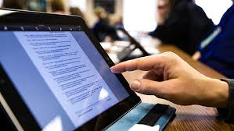
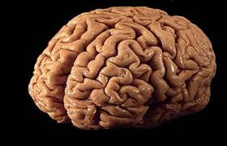
Neuroscience: how it informs Teaching & Learning
August 7, 2018

Slide 2
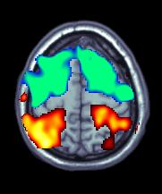
Agenda:
The Brain 101
Neural Plasticity
NeuroMyths
Memory and strategies to enhance learning
The Role of emotion in learning
Summary

Slide 3
Share with a neighbor What would you like to learn about Neuroscience, that would change your teaching practices?

Slide 4
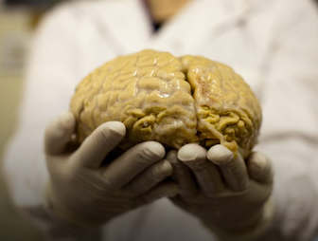
Neuroscience: is the study
of how the nervous system
develops, its structure, and
what it does. The focus is on
the brain and its impact on
behavior and cognitive functions.
We study it’s relationship to behavior and learning.
Understanding Neuroscience is a basis of learning, helping you to improve skills related to teaching.

Slide 5
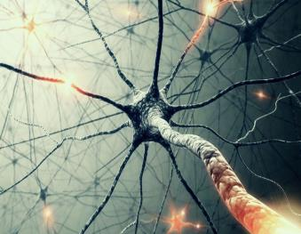
What is Learning
CHANGING the structure & actions of NEURONS so they HOLD INFORMATION in
LONG TERM MEMORY
In TEMPORAL & PARIETAL
LOBES of the CORTEX

Slide 6
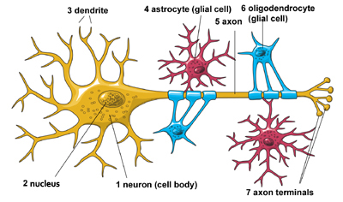
NEURONS (NERVE CELLS) THE HUMAN BODY IS MADE UP OF TRILLIONS OF CELLS. CELLS OF THE NERVOUS SYSTEM, CALLED NERVE CELLS OR NEURONS, ARE SPECIALIZED TO CARRY "MESSAGES" THROUGH AN ELECTROCHEMICAL PROCESS. THE HUMAN BRAIN HAS APPROXIMATELY 100 BILLION NEURONS.
https://faculty.washington.edu/chudler/cells.html
Notes:
Neurons - the basic cell that makes up the nervous system and which receives and sends messages within that system.
Parts of a Neuron: Dendrites - branch-like structures that receive messages from other neurons.
Soma - the cell body of the neuron, responsible for maintaining the life of the cell.
Axon - long tube-like structure that carries the neural message to other cells.
Other Types of Brain Cells: Glial cells - grey fatty cells that: provide support for the neurons to grow on and around, deliver nutrients to neurons, produce myelin to coat axons, Myelin - fatty substances produced by certain glial cells that coat the axons of neurons to insulate, protect, and speed up the neural impulse. clean up waste products and dead neurons.
Neurons in the Body - Nerves – bundles of axons in the body that travel together through the body.

Slide 7
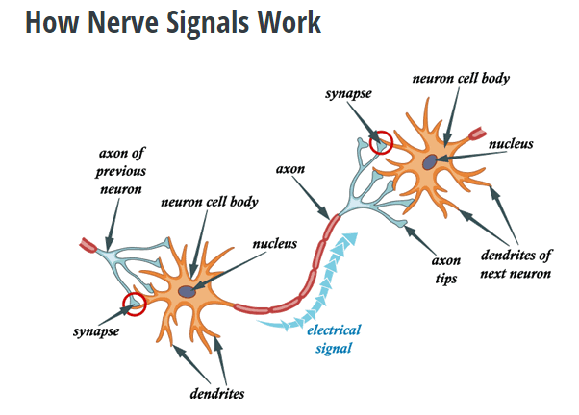
https://faculty.washington.edu/chudler/plast.html
Notes:
A little neuroscience 101 here: neurons are the basic cellular building blocks of the brain. A neuron is made up of dendrites, which receives signals from other neurons, the cell body, which processes those signals and the axon, a long “cable” that reaches out and interacts with other neuron’s dendrites. When different parts of the brain communicate and coordinate with each other, they send nerve impulses, which are electrical charges that travel down the axon of a neuron, eventually reaching the next neuron in the chain.
Imagine a row of dominos stacked closely together – when a neuron fires, it is like knocking down the first domino in a long chain. This process repeats from neuron to neuron, until the nerve signals reach their destination. These firings happen at incredibly fast speeds, which is why your friends are able to “Like” your witty Facebook status update less than a second after you post it.
How Myelination Affects Nerve Impulses
We sometimes refer to our brains as “grey matter” because from the outside, the brain looks mostly grey – that’s what color our neuron cell bodies appear as. But there is also a lot of “white matter” in our brains that fills nearly 50% of our brains.
That white stuff is myelin, a fatty tissue that covers much of the long axons that extend out of our neurons. Scientists have found that myelination increases the speed and strength of the nerve impulses by forcing the electrical charge to jump across the myelin sheath to the next open spot on the axon.
There’s one final point to make here – how do we know myelin improves performance?
Well, that’s tough to prove definitively. We can tell for sure that increases the speed and strength of the nerve impulse – which seems helpful for learning, but not conclusive. However, we can’t just cut into people’s brains and look for myelin directly without running afoul whole bunch of ethical and legal issues.
One compelling piece of evidence comes from brain scans of expert musicians. There’s been a lot of research done on how musician brains differ from the brains of ordinary people – and one specific study used a particular brain scan called Diffusion MRI, which gives us information about tissues and fibers inside the scan region in an non-invasive way.
The takeaway: practicing skills over time causes those neural pathways to work better in unison via myelination. To improve your performance, you need to practice FREQUENTLY, and get lots of feedback so you practice CORRECTLY and enhance the right things.

Slide 8
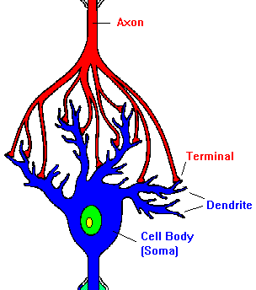
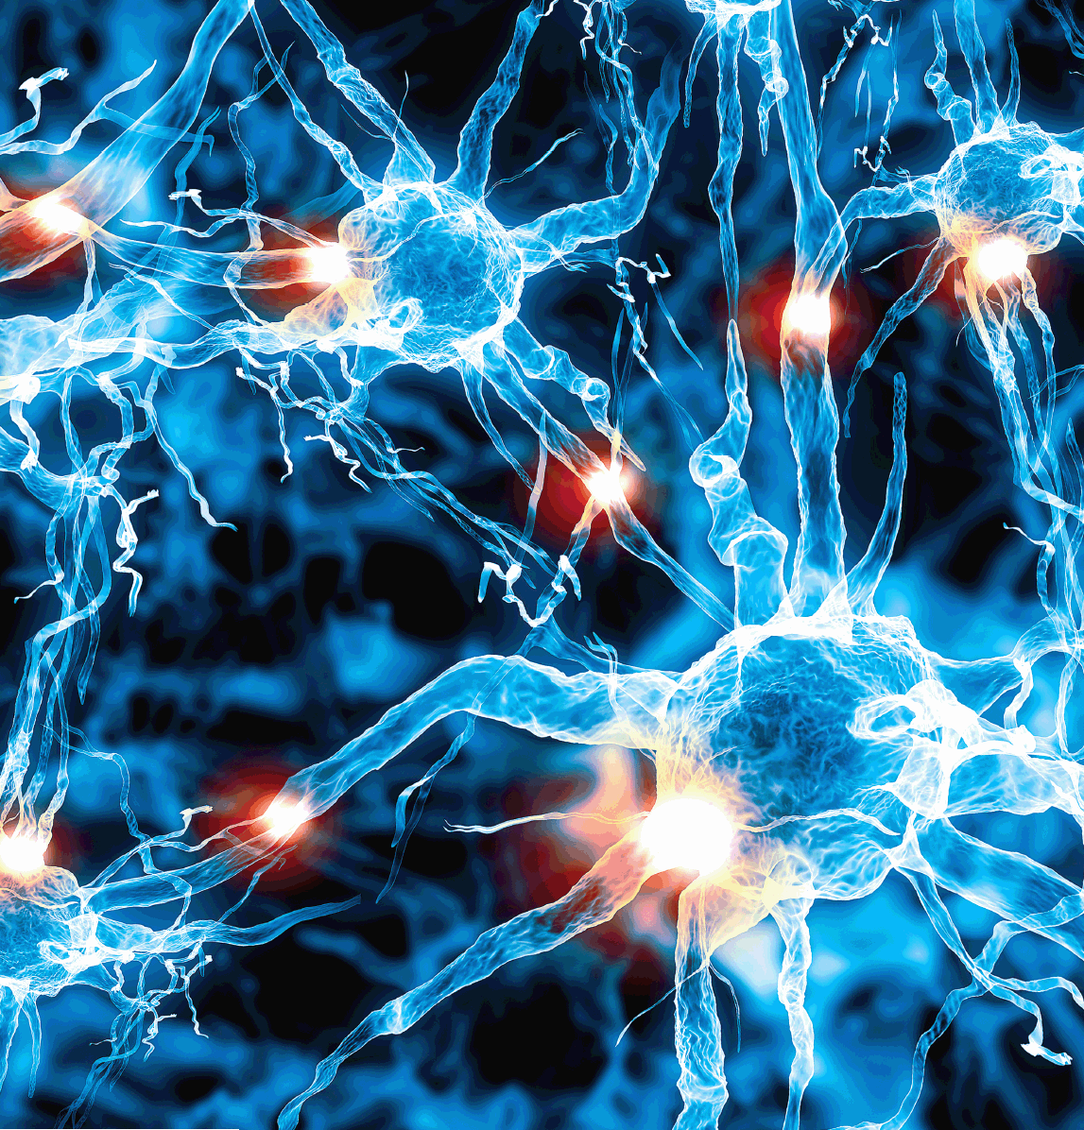
Learning: Neurons make NEW LINKS to communicate with each other. Weak Neuron connections are pruned back
https://faculty.washington.edu/chudler/plast.html
Notes:
Synaptic pruning eliminates weaker synaptic contacts while stronger connections are kept and strengthened. Experience determines which connections will be strengthened and which will be pruned; connections that have been activated most frequently are preserved. Neurons must have a purpose to survive. Without a purpose, neurons die through a process called apoptosis in which neurons that do not receive or transmit information become damaged and die. Ineffective or weak connections are "pruned" in much the same way a gardener would prune a tree or bush, giving the plant the desired shape. It is plasticity that enables the process of developing and pruning connections, allowing the brain to adapt itself to its environment.

Slide 9
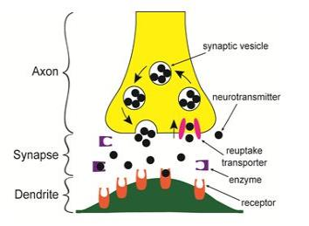
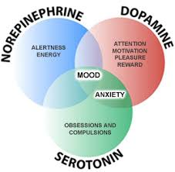
Neurotransmitters
Types of neurotransmitters
Dopamine (Involved in control of
movement/balance, reward/addiction, pleasure, emotion and normal cognition ( thinking).
Serotonin (Involved in memory and stimulates movement.
Norepinephrine (Involved in arousal and mood).
Acetylcholine (Involved in memory and
stimulates movement).
https://faculty.washington.edu/chudler/plast.html
Notes:
Dopamine is a particular neurotransmitter with many roles in the brain, including: - Cardiovascular and renal control - Movement and balance - Reward and addiction - Pleasure, emotion - Normal cognitive function (thinking).

Slide 10
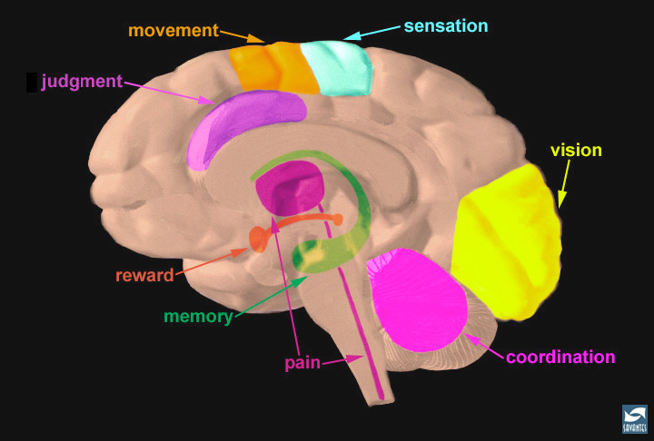
Dopamine

Slide 12
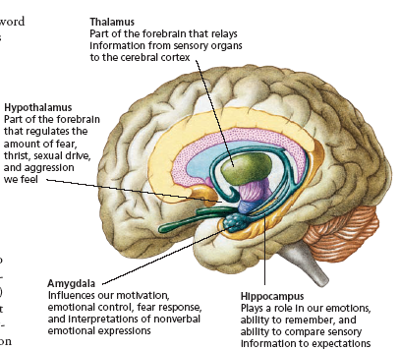
Notes:
Limbic system
Hypothalamus - small structure in the brain located below the thalamus and directly above the pituitary gland, responsible for motivational behavior such as sleep, hunger, thirst, and sex.
Sits above and controls the pituitary gland (master endocrine gland).
Hippocampus - curved structure located within each temporal lobe, responsible for the formation of long-term memories and the storage of memory for location of objects.
Amygdala - brain structure located near the hippocampus, responsible for fear responses and memory of fear.

Slide 13
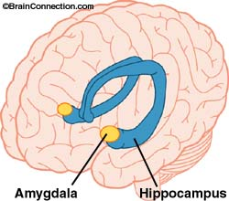
AMYGDALA
Moderates
Emotional intensity
of an experience
Degree of negative or positive emotion
Carlos F. Camargo, PhD
Ohana Foundation Lecture Series 2005
Korean Education Development Institute

Slide 14
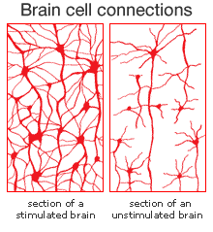
Neuroplasticity
The Brain's ability to reorganize itself
by forming new neural connections
throughout life.
Neuroplasticity allows the neurons
(nerve cells) in the brain to
compensate for injury and disease and to adjust their activities in response to new situations or to changes in their environment.
Brain reorganization can takes place with …undamaged axons that can also sprout nerve endings and connect with other undamaged nerve cells, forming new neural pathways to accomplish a needed function.
http://www.medicinenet.com/script/main/art.asp?articlekey=40362
Notes:
Neuroplasticity: The brain's ability to reorganize itself by forming new neural connections throughout life. Neuroplasticity allows the neurons (nerve cells) in the brain to compensate for injury and disease and to adjust their activities in response to new situations or to changes in their environment.
Brain reorganization takes place by mechanisms such as "axonal sprouting" in which undamaged axons grow new nerve endings to reconnect neurons whose links were injured or severed. Undamaged axons can also sprout nerve endings and connect with other undamaged nerve cells, forming new neural pathways to accomplish a needed function.
For example, if one hemisphere of the brain is damaged, the intact hemisphere may take over some of its functions. The brain compensates for damage in effect by reorganizing and forming new connections between intact neurons. In order to reconnect, the neurons need to be stimulated through activity.

Slide 15
http://www.slideshare.net/vansantr/playing-with-the-brain?qid=b5a55e0f-498a-43a6-95ba-8084788e063c&v=&b=&from_search=3

Slide 16
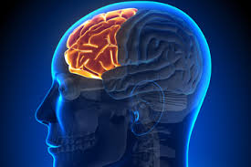
FRONTAL LOBE
Stores the reward value of experience
Activates behaviors leading to the most rewarded outcome
Carlos F. Camargo, PhD
Ohana Foundation Lecture Series 2005
Korean Education Development Institute

Slide 17
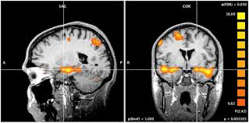
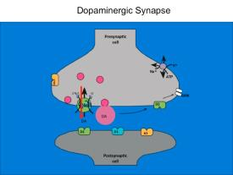
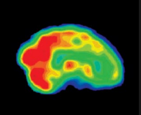
Human Motivation system
Rewarding experiences
trigger amygdala activity
trigger dopamine release
trigger frontal lobe activity
Carlos F. Camargo, PhD
Ohana Foundation Lecture Series 2005
Korean Education Development Institute

Slide 18
Increased Dopamine IS the Reward
Carlos F. Camargo, PhD
Ohana Foundation Lecture Series 2005
Korean Education Development Institute

Slide 19
Greenfield, S. ( 1915) The image of technology on the brain. 2015 AICD Conference

Slide 20
Brain Functioning Quiz
Source: Testmybrain.org

Slide 21
Share with a neighbor How does this information change your thinking about learning?

Slide 22
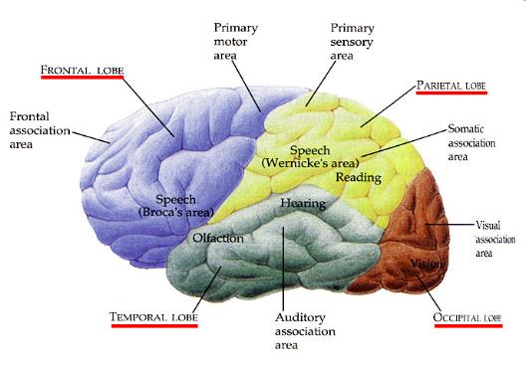
Memory & Strategies
to enhance Learning

Slide 23
Source: Joanna West, Presentation on theme: "Common Core State Standards Session 7 6-12 Social Studies, Science, & CTE.“ - http://slideplayer.com/slide/6202381/

Slide 24
Motivation to Learn School Subjects are Conditioned
Most cultures condition children
with 3 primary rewards for successful learning using:
Food
Educator & Parent approval
Increased peer social status
Carlos F. Camargo, PhD
Ohana Foundation Lecture Series 2005
Korean Education Development Institute

Slide 25
We are motivated to LEARN to get 5 Primary Social Rewards
Feel pleasant touch (Rolls et al. 2003)
See attractive faces (Aharon et al. 2001)
Hear positive words (Hamann & Mao 2002)
Interact with others (Rilling et al. 2002)
Gain social status
(Tooby & Cosmides, 2002)
Carlos F. Camargo, PhD
Ohana Foundation Lecture Series 2005
Korean Education Development Institute

Slide 26
Major promoters of learning =
REPETITION of INFORMATION
(Squire and Kandel, 2000)
EXCITEMENT at the time of learning
(Cahill & Gorski, 2003; LeDoux, 2002)
EATING CARBOHYDRATES at time of learning (Korol, 2002)
8-9 HOURS OF SLEEP after learning (Kuriyama, Stickgold, & Walker, 2004)\
Carlos F. Camargo, PhD
Ohana Foundation Lecture Series 2005
Korean Education Development Institute

Slide 27
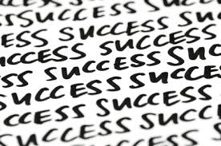
The 1st Learning Promoter is REPETITION
Squire & Kandel (2000)
Reviewed neurobiology of learning
Brain forms long term memories depending on
“the number of times the event or fact is repeated”
Carlos F. Camargo, PhD
Ohana Foundation Lecture Series 2005
Korean Education Development Institute
Notes:
We all unconsciously repeat important information in conversations
All cultures teach important stories by verbal repetition
Chinese educators were taught to say everything TWICE…
Most educators discover that repetition is valuable

Slide 28
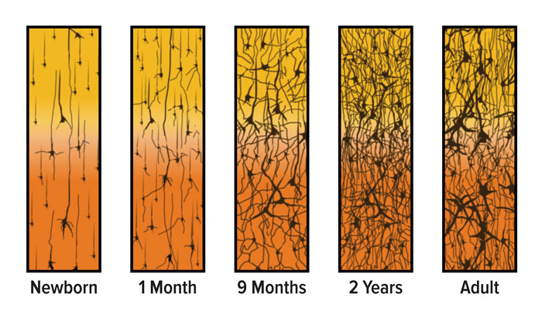
Repetition causes neurons to make MORE CONNECTIONS with other neurons
Carlos F. Camargo, PhD
Ohana Foundation Lecture Series 2005
Korean Education Development Institute
Notes:
Neural circuits maturing at different ages in the brain

Slide 29
K. Kryza: Developing growth mindsets in the classroom. WWW. Inspiringlearners.com
Notes:
ILS = Inspiring learning strategies

Slide 30
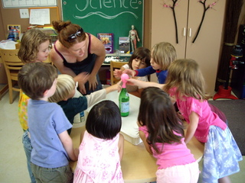
The role of Emotion in Learning: A learning promoter is EXCITEMENT
LeDoux has studied the brain for 30 years & reported (2002) that “we remember particularly well…those things that arouse our emotions”
Carlos F. Camargo, PhD
Ohana Foundation Lecture Series 2005
Korean Education Development Institute

Slide 31
Excitement automatically increases certain neurotransmitters
Carlos F. Camargo, PhD
Ohana Foundation Lecture Series 2005
Korean Education Development Institute

Slide 32
Excitement sets NEURON CONNECTIONS in the “ON” position
Carlos F. Camargo, PhD
Ohana Foundation Lecture Series 2005
Korean Education Development Institute

Slide 33
Another learning promoter is EATING CARBOHYDRATES (Complex-Whole grains, non processed foods, etc)
Greenwood and Winocur (2001) research: high-fat diet impairs brain glucose metabolism needed to form long term memory
Korol (2002) research: eating carbohydrates enhanced memory
(Smith, 2003) research: lack of breakfast impairs learning
Carlos F. Camargo, PhD
Ohana Foundation Lecture Series 2005
Korean Education Development Institute

Slide 34
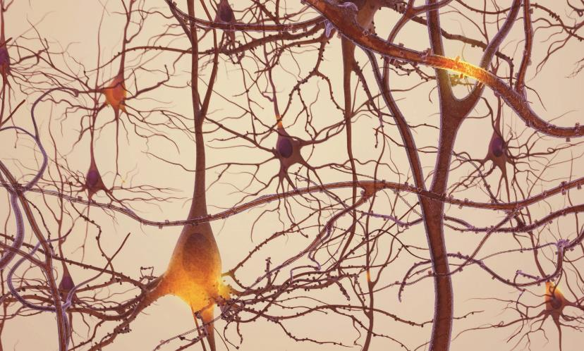
Eating carbohydrates provides glucose to make glycoproteins that organizes new synapse locations & binds neurons to one another.
Carlos F. Camargo, PhD
Ohana Foundation Lecture Series 2005
Korean Education Development Institute

Slide 35
SLEEP IS A FREE LEARNING TOOL
DREAMING SLEEP promotes differential strengthening of neurons in networks holding learned information
NON-DREAMING SLEEP activates calcium channels that biologically repeat the neural path of learning to force long term storage
Not very effective to
consolidate learning.
Carlos F. Camargo, PhD
Ohana Foundation Lecture Series 2005
Korean Education Development Institute

Slide 36
DREAMING SLEEP causes differential strengthening by altering neurotransmitters
Carlos F. Camargo, PhD
Ohana Foundation Lecture Series 2005
Korean Education Development Institute

Slide 37
Research shows that TOO LITTLE SLEEP or IMPAIRED SLEEP = IMPAIRED LEARNING
←Alcohol ingested after a day of learning inhibits dreaming sleep and impairs memory storage of the day’s information
←Drugs of abuse used after learning have similar bad effects on sleep and the day’s learning
←A majority of teens, college students and working adults in the US are sleep-deprived
Carlos F. Camargo, PhD
Ohana Foundation Lecture Series 2005
Korean Education Development Institute

Slide 38
Of the major learning promoters
REPETITION of INFORMATION
(Squire and Kandel, 2000)
EXCITEMENT at the time of learning
(Cahill & Gorski, 2003; LeDoux, 2002)
EATING CARBOHYDRATES at time of learning (Korol, 2002)
8-9 HOURS OF SLEEP after learning (Kuriyama, Stickgold, & Walker, 2004)\
Carlos F. Camargo, PhD
Ohana Foundation Lecture Series 2005
Korean Education Development Institute

Slide 39
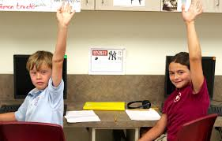
TEACHERS CAN CONTROL these PROMOTERS
Repetition
&
Excitement
Carlos F. Camargo, PhD
Ohana Foundation Lecture Series 2005
Korean Education Development Institute

Slide 40
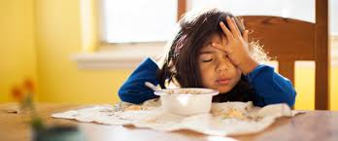
Parents CAN influence and Control these PROMOTERS
Diet
&
Sleep
Carlos F. Camargo, PhD
Ohana Foundation Lecture Series 2005
Korean Education Development Institute

Slide 41
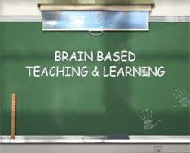
Studies have concluded Teachers should
We cannot multitask. Focus only on one task and topic at a time.
We cannot hold Teach (each topic and task) in information for more 10 min intervals.
than 10 min.
We can recognize patterns Explain the entire topic in one
better than details. minute & connect it to a core concept.
We can better map End each 10 minute interval with information to our brain an interesting hook.
when we have increased
attention and motivation.
Repetition is helpful to long Cycle through the same lesson 3 term memory. times per day.
Rodriguez, Vanessa. The teaching Brain. WWW.teachingbrain.org

Slide 43
Resources - Sources
Amen Clinics Atlas: http://amenclinics.com/bp/atlas/
Great website sponsored by Amen Clinics Inc., A Medical Corporation.
Autonomic Nervous System: http://faculty.washington.edu/chudler/auto.html
Summary of information about the structure and function of the autonomic nervous system.
Basic Neural Processes Tutorials: http://psych.hanover.edu/Krantz/neurotut.html
Learn about basic brain functioning.
Brain and Behavior : http://serendip.brynmawr.edu/bb/
Large site - contains lots of links to information about the brain & behavior. Students can complete several interactive exercises to learn more about brain functions.
Brain & Mind – Electronic Magazine on Neuroscience http://www.epub.org.br/cm/
Includes a wealth of short articles devoted to the brain.
Brain Model Tutorial: http://pegasus.cc.ucf.edu/~Brainmd1/brain.html
This site teaches students about the various parts of the human brain and allows them to test their knowledge of brain structures.
Carlos F. Camargo, PhD The Neuroscience of Learning. Ohana Foundation Lecture Series 2005
Korean Education Development Institute
The Human Brain: A Learning Tool: http://uta.maymt.edu/~psychol/brain.html
Close-up pictures of the brain’s lobes.
Neuroscience for Kids: http://faculty.washington.edu/chudler/neurok.html
Shen, Jason. Why practice actually makes perfect: How to rewire your brain for better performance. https://blog.bufferapp.com/why-practice-actually-makes-perfect-how-to-rewire-your-brain-for-better-performance
Van Sant, Rick. "Implications of Brain Research on Game and Simulation Design." Implications of Brain Research on Game and Simulation Design. N.p., n.d. Web. 09 May 2016. <http://www.slideshare.net/vansantr/playing-with-the-brain?qid=b5a55e0f-498a-43a6-95ba-8084788e063c&v=&b=&from_search=3>.
Whole Brain Atlas: http://www.med.harvard.edu:80/AANLIB/home.html

