Slide 1
Neuroscience and nursing education; the millennials
EDCI 545 – Neuroscience and Learning – Vanessa Jones-Oyefeso

Slide 2
21st century nursing education
Fast-paced
Rigorous academic coursework
Technical skills - unique Skill set
Specialization

Slide 3
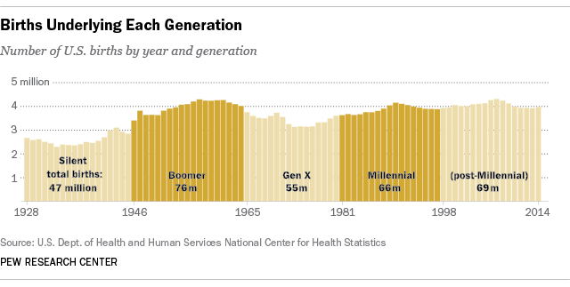

Slide 4
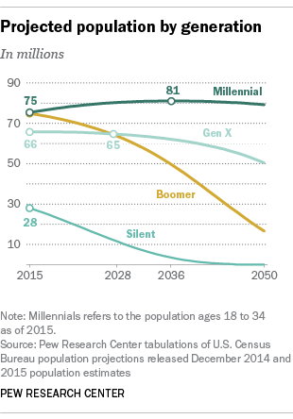

Slide 5
The generations Johnson & Romanello, 2005
Silent (1925-1942)
Value hard work and frugality
Conformity, consistency, uniformity
Baby boomer (1943-1960)
Equate work with self-worth
“I can change the world mentality”
Generation X (1961-1981)
Ironic, clever, resourceful
Millennials (1982-2002)
Emphasis on traditional norms and values
Driven and dedicated
Know how to win
Has many goals to accomplish at the same time
Optimistic, positive, assertive
Accustomed to structure
Are team players

Slide 6
Generational learning styles Johnson & Romamello, 2005
Baby boomers | Generation X | Millennials
Contact with faculty | Want to learn what is of direct use | Use of technology
Want to learn in caring environment | Enjoys flexible learning times | No tolerance for delays
Lecture | Class assignments are a means to an end – college degree | Simulations with immediate feedback
Detailed handout | Distance learning courses | Small group activities
Note taking | Detailed study guides and test reviews | Creative and innovative interactive exercises

Slide 7
Millenials – additional considerations
Prefer to multitask
Emerging adulthood
Structure
Purgatorial zone
dualistic versus multiplistic versus relativistic thinking

Slide 8
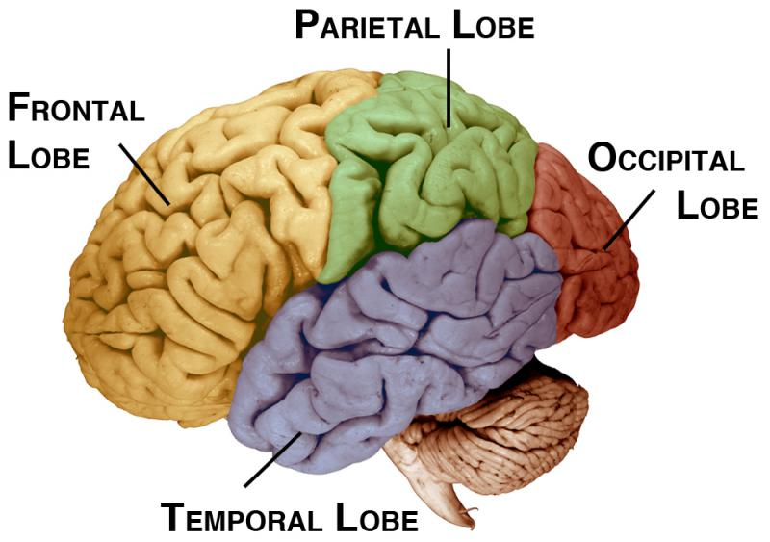
Lobes of the brain
Occipital lobe
Located at the posterior portion of the cortex
Known as the primary visual cortex/striate cortex
Perception of an object
Has this object been stored in visual memory
Visual stimuli is meaningful when the sensory perceptions match a cognitive association
We can prime the brain to be attentive
Tell the students the objective of an activity – increase attentiveness

Slide 9
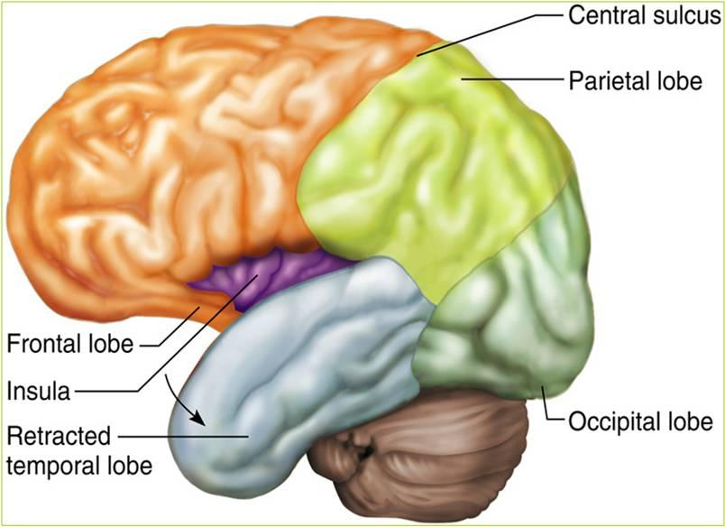
Lobes of the brain
Parietal lobe
Lies between the occipital lobe and the central sulcus
Monitors all the information about eye, head, and body positions and relays this information to areas of the brain that control movement
Essential for spatial and numerical information

Slide 10
Lobes of the brain
Temporal lobe
Primary cortical target for auditory information – essential for understanding spoken language - Wernicke’s area
Contributes to complex aspects of vision including perception of movement and recognition of faces
Important for emotional and motivational behaviors

Slide 11
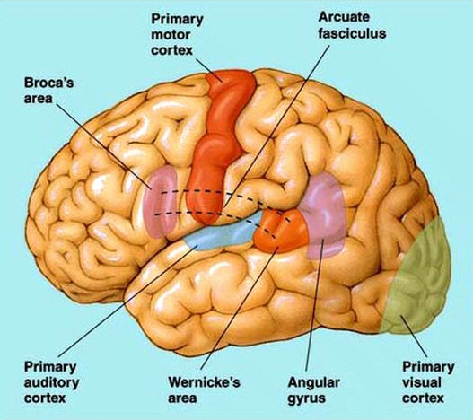
Lobes of the brain
Frontal lobe
Contains the primary motor and prefrontal cortex
Precentral gyrus
Specialized for the control of fine movements
Borca's area
Prefrontal lobe
Important for working memory – enhance the response to relevant information and decreases responses to distractors
Working memory – ability to remember recent events
Have trouble with delayed-response task – delayed response to visual and auditory stimuli
For making decisions and planning movements
Damage to this area leads to impulsive behaviors - did not weigh the pros and cons

Slide 12
Memory formation
The hippocampus
Stores immediate past memories
Sends memory to the cerebral cortex

Slide 13
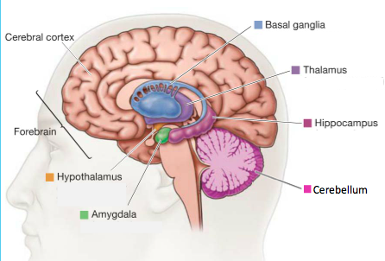
Subcortical Structures
Thalamus
Forms the diencephalon
Main source of input is from cerebral cortex
Sensory input is processed here and sent to the cerebral cortex with the exception of smell
Hypothalamus
Ventral to the thalamus
Conveys information to the pituitary gland and either promotes or inhibits the release of hormones
Damage to this structure leads to abnormalities in motivated behaviors

Slide 14
Subcortical Structures
Pituitary gland
An endocrine gland attached to the base of the hypothalamus
Synthesizes hormones in response to input from the hypothalamus
Basal ganglia
Lateral to the thalamus
Three major structures
Caudate nucleus, putamen, globus pallidus
Assists is control of movement
Integrates emotional and motivational behavior
Critical for learning and remembering skills and habits

Slide 15
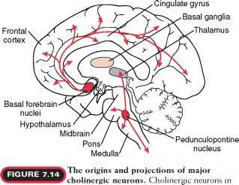
Subcortical Structures
Basal forebrain
Nucleus basalis located here
Receives input from the hypothalamus and basal ganglia
Sends axons that release acetylcholine to the cerebral cortex
Important for wakefulness and attention
Person’s with Parkinson’s and Alzheimer’s disease have decrease activity or deterioration of this structure
Hippocampus
Lies between the thalamus and the cortex
Critical for memories of individual events

Slide 16
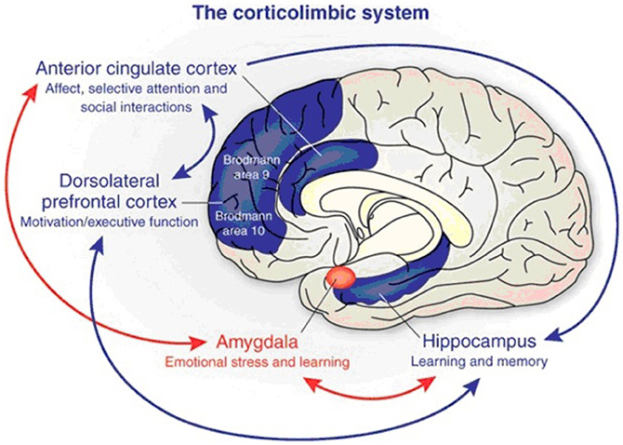
Subcortical Structures
Amygdala
Controls emotions
Thalamus sends information to this structure for evaluation
If the stimulus is deemed harmful the amygdala with send messages to the hypothalamus → hormonal release
? Forms emotional memories

Slide 17
How can neuroscience inform teaching to the millennial
Presentation Overview
Electrolyte imbalances
Sodium
Potassium
Calcium
Magnesium
Phosphorus

Slide 18
How can neuroscience inform teaching to the millennial
Presentation Outcomes
Develop an understanding of the importance of reviewing preoperative laboratory electrolyte values and utilize this information to formulate an anesthetic care plan for the patient.
Know the clinical manifestations for decreased and increased levels of sodium, potassium, calcium, magnesium and phosphate.
Discuss the significance of and the anesthetic implication(s) for decreased and increased levels of sodium, potassium, calcium, magnesium and phosphate.

Slide 19
How can neuroscience inform teaching to the millennial
Left brain
Right brain
Structured
Sequence
Language oriented
Examination
Analytical
Imaginative
Seeks patterns
Creates metaphors
Simultaneous
Consolidation of information

Slide 20
How can neuroscience inform teaching to the millennial
Right hemisphere - context
Teach to both halves of the brain
Left hemisphere - content

Slide 21
NRSG 520 – Principles of Nurse Anesthesia Practice I Electrolyte Disturbance Review Questions March 7, 2017
What are characteristics of the intracellular and extracellular fluid compartments of the body?
What are the classifications of hyponatremia?
What causes of hyponatremia should the nurse anesthetist be concerned with?
What signs and symptoms may the patient with hyponatremia present with?
What is myelinolysis and when can this occur?
What is the main cause of hypernatremia and which patient populations are at risk?
What are other causes of hypernatremia?
What signs and symptoms may the patient with hypernatremia present with?

Slide 22
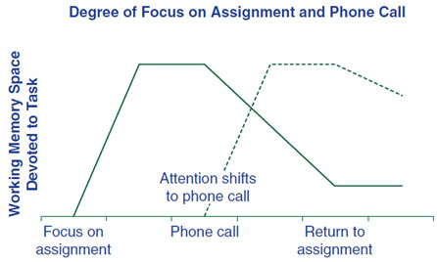
How can neuroscience inform teaching to the millennial
Multitasking -

Slide 23
“An effective classroom climate might be described as one that allows students to naturally increase the endorphin, dopamine, norepinephrine, or serotonin levels in their brains, making the students’ education experiences more pleasurable and rewarding”
Wolfe, pg. 69

Slide 24
references
Fry, R. (2015). Millenials overtake Baby boomers as America's largest population. Retrieved from http://www.pewresearch.org/fact-tank/2016/04/25/millennials-overtake-baby-boomers
Johnson, S. A. (2005). Generational diversity: Teaching and learning approaches. Nurse Educator, 30, 5, 212-216
McGlynn, A. P. (2005). Teaching millenials, our newest cultural cohort. Education digest. Retrieved from http://www.sciencetheearth.com/uploads/2/4/6/5/24658156/mcglynn_teachingmillenials.pdf
Pardue, K. T. & Morgan, P. T. (2008). Millenials considered: a new generation, new approaches, and implications for nursing education. Nursing education perspectives. 29, 2, 74-79
Sousa, D. A. (2011)). How the brain learns (5th Ed)Thousand Oaks, CA :Corwin
Wolfe, P. (2010). Brain matters: Translating research into classroom practice (2nd Ed). Alexandria, VA: ASCD

