Slide 1
The Brain for Second Graders: Brain Basics
By: Michelle Coy
EDCI545 Brain Science and Learning
La Sierra University – Dr. Caviness
Part One >
Notes:
This is a introductory presentation about the brain with second graders as the target audience.

Slide 2
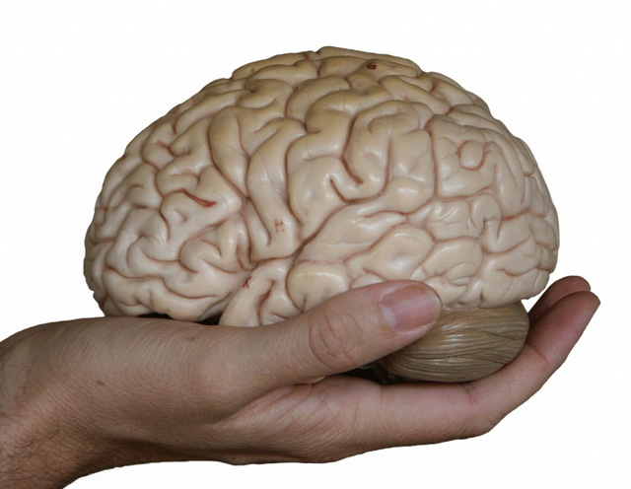
The Brain
http://fresh.spiffystores.com/products/grapefruit
http://www.walnutstudio.net/
http://uncyclopedia.wikia.com/wiki/File:Brain-in-hand.jpg
3
1
2
Notes:
The brain is “about the size of a small grapefruit” (p. 15).
It is “shaped like a walnut” (p. 15).
It can “fit in the palm of your hand” (p. 15).
The brain is a “wet, fragile mass that weighs a little more than three pounds” (p. 15).
Fist for a Brain (p. 36)
“Extend both arms with palms open and facing down and lock your thumbs.”
“Curl your fingers to make two fists.”
Turn your fists inward until the knuckles touch.”
That’s about how big your brain is!
Sousa, D.A. (2011). How the brain learns. Thousand Oaks, CA: Corwin.

Slide 3
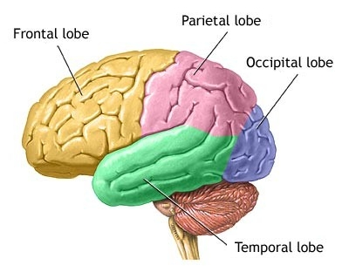
The Outside of the Brain:
http://commonsenseatheism.com/?p=13607
Notes:
There are four lobes/parts of the brain. This is looking at the outside of the brain.
Let’s go over each part and the basics of what each lobe does.

Slide 4
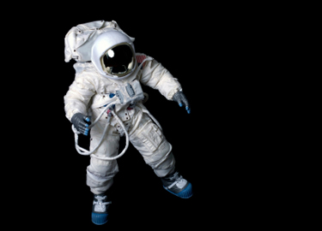
Parietal Lobe
http://www.memorylossonline.com/glossary.htm
http://www.sciencelet.com/2012/10/astronauts-float-not-because-there-is-no-gravity.html
SPAce > PArietal > SPAcial Awareness
Notes:
The Parietal Lobe “deal[s] mainly with spatial orientation, calculation, and certain types of recognition” (p. 17). Sousa, D.A. (2011). How the brain learns. Thousand Oaks, CA: Corwin.
Remember the PA in Space matches the PA in parietal. This will help you remember that the parietal lobe is in charge of S PA cial awareness, knowing where you are in space.

Slide 5
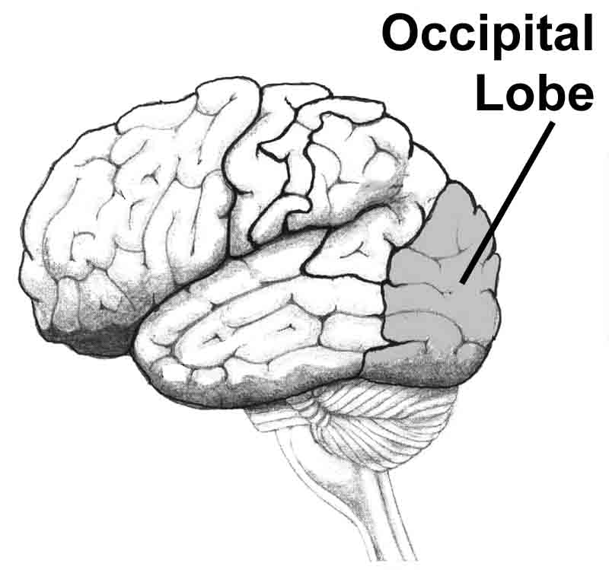
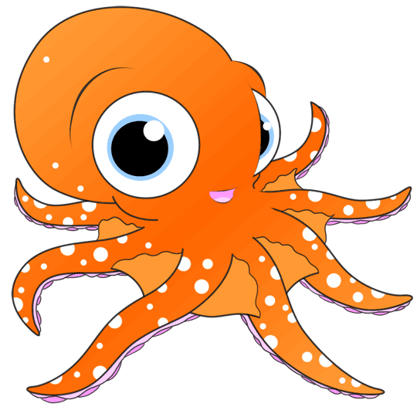
Occipital Lobe
http://www.memorylossonline.com/glossary.htm
http://www.how-to-draw-cartoons-online.com/cartoon-octopus.html
Octopus > Occipital > Eyes
Notes:
“The occipital lobe are almost used almost exclusively for visual processing” (p. 17).
Sousa, D.A. (2011). How the brain learns. Thousand Oaks, CA: Corwin.
Picture an octopus with BIG eyes. This will remind you that the occipital lobe is responsible for vision.

Slide 6
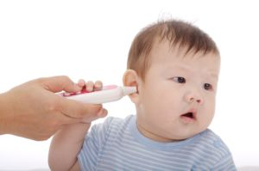
Temporal Lobe
http://www.baby-safety-concerns.com/best-thermometer.html
http://www.memorylossonline.com/glossary.htm
Temperature > In ear > Temporal
Notes:
The temporal lobe controls “sound, music, face and object recognition, and some parts of long-term memory” (p. 27).
It also deals with speech. (p. 27) Sousa, D.A. (2011). How the brain learns. Thousand Oaks, CA: Corwin.
Temporal sounds like temperature. Babies get their temperature taken in their ears. This will help you know that the temporal lobe’s job is to deal with sound and speech.

Slide 7
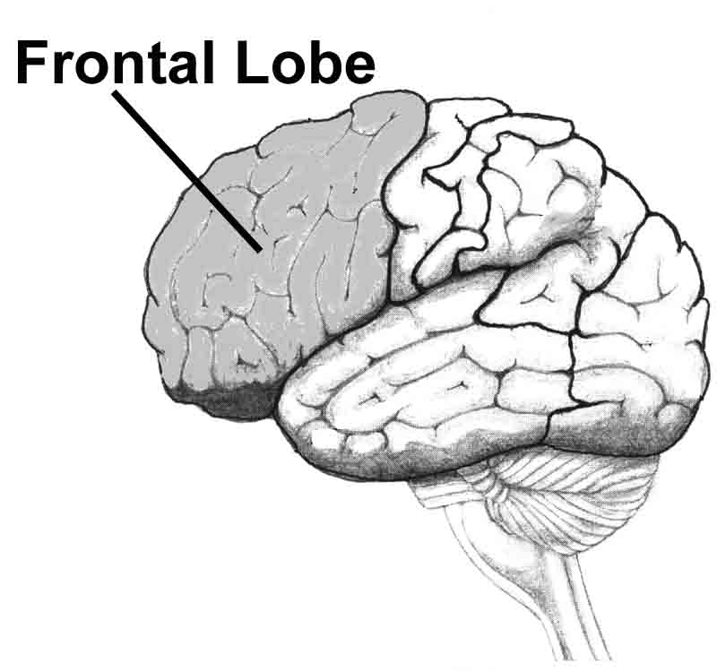
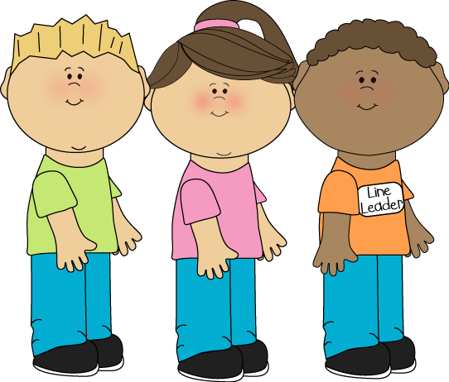
Frontal Lobe
http://www.mycutegraphics.com/graphics/school/school-kids/line-leader.html
http://www.memorylossonline.com/glossary.htm
Front of line > Frontal > Leader
Notes:
(Prefrontal cortex)
“Often called the executive control center, these lobes deal with planning and thinking. . . Monitoring higher-order thinking, directing problem solving, and regulating the excesses of the emotional system. The frontal lobe also contains our self-will area – what some might call our personality” (p. 17).
Sousa, D.A. (2011). How the brain learns. Thousand Oaks, CA: Corwin.
Who likes to be line leader. When you are line leader you are in charge of the line. You have lots of choices. You have to think more than the others in the line. This will help you remember how important the frontal lobe is, especially to higher order thinking and problem solving.

Slide 8
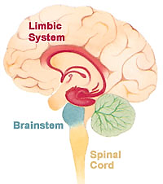
The Inside of the Brain:
Cerebrum
3 pounds > 3 parts
Cerebrum
Limbic System
The Brain Stem
https://www.boundless.com/psychology/textbooks/boundless-psychology-textbook/the-brain-and-behavior-4/the-brain-35/the-limbic-system-154-12689/
Notes:
There are three major areas inside brain.
Let’s go over each part.
Sousa, D.A. (2011). How the brain learns. Thousand Oaks, CA: Corwin.

Slide 9
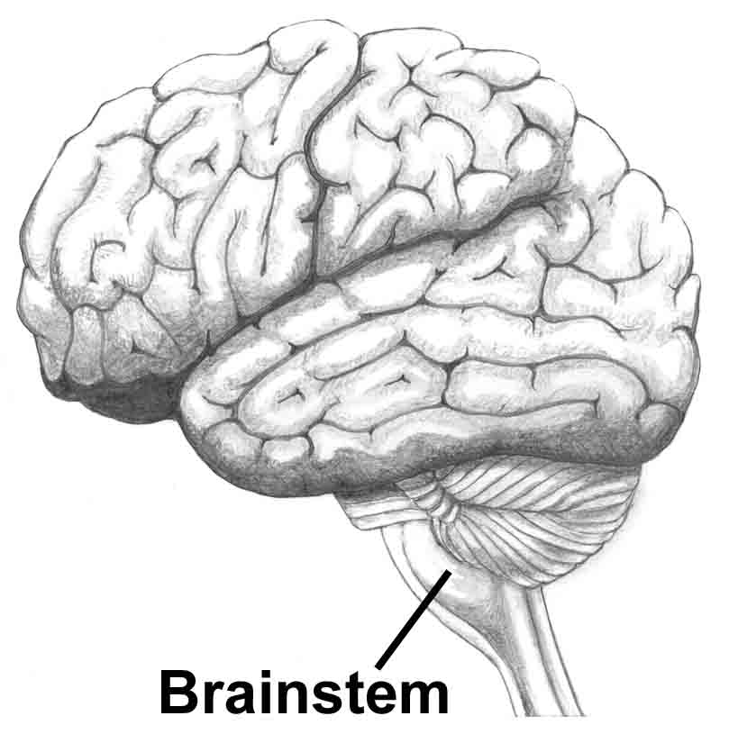
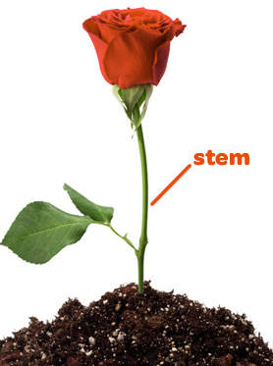
The Brain Stem
http://www.memorylossonline.com/glossary.htm
http://sni.scholastic.com/SN1/03_04_12_SN1/book
Plant Stem > Stem > Controls Plant
http://www.mycutegraphics.com/graphics/school/school-kids/line-leader.html
Notes:
“Here is where vital body functions, such as heartbeat, respiration [breathing], body temperature, and digestion, are monitored and controlled” (p. 18).
(Sousa, D.A. (2011). How the brain learns. Thousand Oaks, CA: Corwin.
Just like the plant stem controls the plant’s life (water intake, nutrient travel, etc.), the brain stem controls the brain’s important jobs.

Slide 10
The Limbic System
http://yourkidsed.com.au/info/getting-our-kids-back-outdoors
Limb > Limbic > Learning and Memory
http://www.mycutegraphics.com/graphics/school/school-kids/line-leader.html
Notes:
The Limbic System has many important jobs. Best of all the Limbic System helps with learning and memory.
(Sousa, D.A. (2011). How the brain learns. Thousand Oaks, CA: Corwin.
Imagine you are climbing a tree. You are learning for the first time. You climb so high that the tree limb is too small. You feel like you’re going to fall. Next time your memory will remind you not to climb so high. That’s your Limbic System at work.

Slide 11
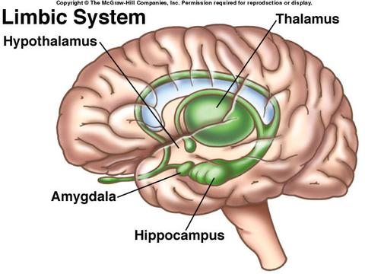
The Limbic System’s Four Parts
http://www.mhhe.com/cgi-bin/netquiz_get.pl?qfooter=/usr/web/home/mhhe/biosci/genbio/enger/student/olc/art_quizzes/0665fq.htm&afooter=/usr/web/home/mhhe/biosci/genbio/enger/student/olc/art_quizzes/0665fa.htm&test=/usr/web/home/mhhe/biosci/genbio/enger/student/olc/art_quizzes/0665q.txt&answers=/usr/web/home/mhhe/biosci/genbio/enger/student/olc/art_quizzes/0665a.txt
http://www.mycutegraphics.com/graphics/school/school-kids/line-leader.html
Notes:
The Limbic System has four main parts.

Slide 12
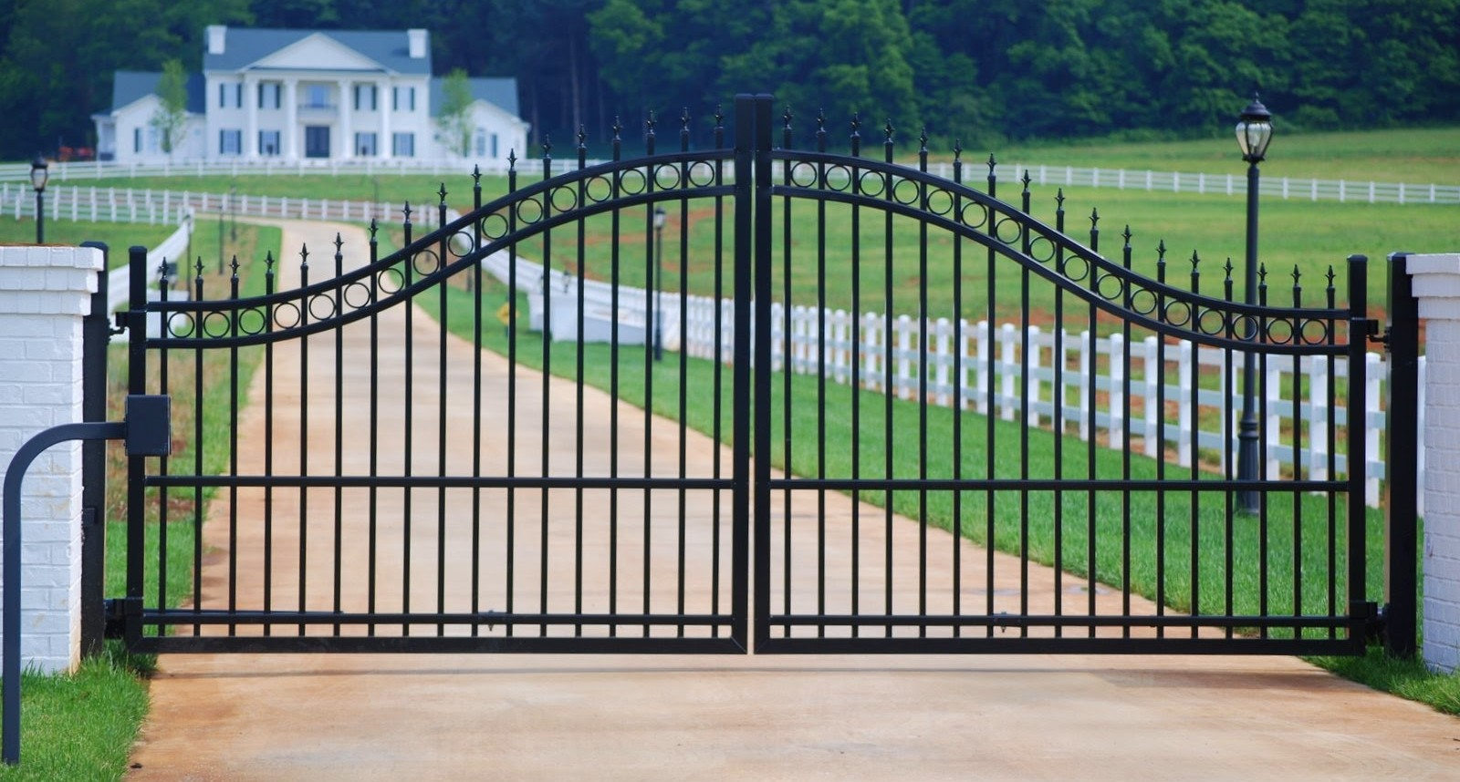
Thalamus (Limbic System)
THALAMUS
http://glennstone.net/gate-system-fence-springfield-mo/
http://www.mhhe.com/cgi-bin/netquiz_get.pl?qfooter=/usr/web/home/mhhe/biosci/genbio/enger/student/olc/art_quizzes/0665fq.htm&afooter=/usr/web/home/mhhe/biosci/genbio/enger/student/olc/art_quizzes/0665fa.htm&test=/usr/web/home/mhhe/biosci/genbio/enger/student/olc/art_quizzes/0665q.txt&answers=/usr/web/home/mhhe/biosci/genbio/enger/student/olc/art_quizzes/0665a.txt
Must open gate > ThalaMUS > Gateway to Cortex
http://www.mycutegraphics.com/graphics/school/school-kids/line-leader.html
Notes:
“All incoming sensory information (except smell) goes first to the thalamus” (p. 18)
Sousa, D.A. (2011). How the brain learns. Thousand Oaks, CA: Corwin.
The thalamus is the gate into the brain. It guards against all information coming in from the outside of the body. Picture a gate that you must open to get into your house.

Slide 13
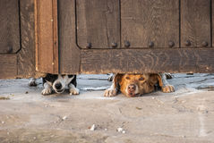
Hypothalamus (Limbic System)
HYPOTHALAMUS
http://www.dreamstime.com/photos-images/dog-looking-gate.html
http://www.mhhe.com/cgi-bin/netquiz_get.pl?qfooter=/usr/web/home/mhhe/biosci/genbio/enger/student/olc/art_quizzes/0665fq.htm&afooter=/usr/web/home/mhhe/biosci/genbio/enger/student/olc/art_quizzes/0665fa.htm&test=/usr/web/home/mhhe/biosci/genbio/enger/student/olc/art_quizzes/0665q.txt&answers=/usr/web/home/mhhe/biosci/genbio/enger/student/olc/art_quizzes/0665a.txt
Hypo = Below > Hypothalamus > Below brain
http://www.mycutegraphics.com/graphics/school/school-kids/line-leader.html
Notes:
“Just below the thalamus” (p. 18)
“The hypothalamus monitors the internal systems to maintain the normal state of the body. . . It moderates numerous body functions, including sleep, body temperature, food intake, and liquid intake (p. 18).
(Sousa, D.A. (2011). How the brain learns. Thousand Oaks, CA: Corwin.
Picture a dog peeking out below a gate. The dog is inside and making sure everything is o.k. in the yard. The hypothalamus watches what’s happening inside the body (below the brain – and in the brain).

Slide 14
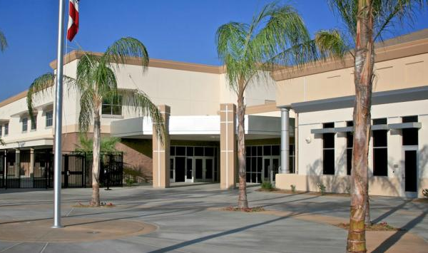
Hippocampus (Limbic System)
http://www.lla.org/admissions/business-office and http://www.dreamstime.com/illustration/hippopotamus.html
http://www.mhhe.com/cgi-bin/netquiz_get.pl?qfooter=/usr/web/home/mhhe/biosci/genbio/enger/student/olc/art_quizzes/0665fq.htm&afooter=/usr/web/home/mhhe/biosci/genbio/enger/student/olc/art_quizzes/0665fa.htm&test=/usr/web/home/mhhe/biosci/genbio/enger/student/olc/art_quizzes/0665q.txt&answers=/usr/web/home/mhhe/biosci/genbio/enger/student/olc/art_quizzes/0665a.txt
Hippo goes to campus to learn > Hippocampus > Learning and Remembering
http://www.mycutegraphics.com/graphics/school/school-kids/line-leader.html
Notes:
“It plays a major role in consolidating learning and in converting information from working memory. . . This process is essential for the creation of meaning” (p. 19).
(Sousa, D.A. (2011). How the brain learns. Thousand Oaks, CA: Corwin.
Pretend a hippo came to our school to learn and remember. Campus is a synonym for school. The hippocampus helps us learn and remember.

Slide 15
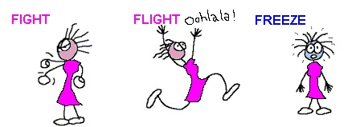
Amygdala (Limbic System)
https://conexaoieblog.wordpress.com/monstros/
http://www.mhhe.com/cgi-bin/netquiz_get.pl?qfooter=/usr/web/home/mhhe/biosci/genbio/enger/student/olc/art_quizzes/0665fq.htm&afooter=/usr/web/home/mhhe/biosci/genbio/enger/student/olc/art_quizzes/0665fa.htm&test=/usr/web/home/mhhe/biosci/genbio/enger/student/olc/art_quizzes/0665q.txt&answers=/usr/web/home/mhhe/biosci/genbio/enger/student/olc/art_quizzes/0665a.txt
Emergency Word > Amygdala >
Fight, Flight, or Freeze
http://www.mycutegraphics.com/graphics/school/school-kids/line-leader.html
Notes:
“Plays an important role in emotions, especially fear. It regulates the individual’s interactions with the environment that can affect survival, such as whether to attach, escape, mate, or eat” (p. 19)
(Sousa, D.A. (2011). How the brain learns. Thousand Oaks, CA: Corwin.
Our classroom emergency word is amygdala. This part of the brain takes in your emotions and decides whether to fight, flee, or freeze. When you hear this word what should you do? (FREEZE!)

Slide 16
Cerebrum
3 syllables > 3 main jobs
Thinking/Memory
Speech
Muscle Movement
http://www.majordifferences.com/2014/03/difference-between-cerebrum-and.html#.VI5_t3u1ctM
Notes:
“Largest Area”
“Gray Matter” (p. 20)
Sousa, D.A. (2011). How the brain learns. Thousand Oaks, CA: Corwin.

Slide 17
Bonus: Cerebellum
http://www.crossdenominationalmission.org.uk/bells.html
http://www.theblaze.com/stories/2011/09/27/borg-technology-rat-gets-synthetic-cerebellum-and-it-works/
Bell > Cerebellum > Swinging = Movement
Notes:
“Little brain”
“Coordinates movement” (p. 20)
Sousa, D.A. (2011). How the brain learns. Thousand Oaks, CA: Corwin.

Slide 18
The Brain for Second Graders: How you Learn
By: Michelle Coy
EDCI545 Brain Science and Learning
La Sierra University – Dr. Caviness
Part Two >
Notes:
This is a introductory presentation about the brain with second graders as the target audience.

Slide 19
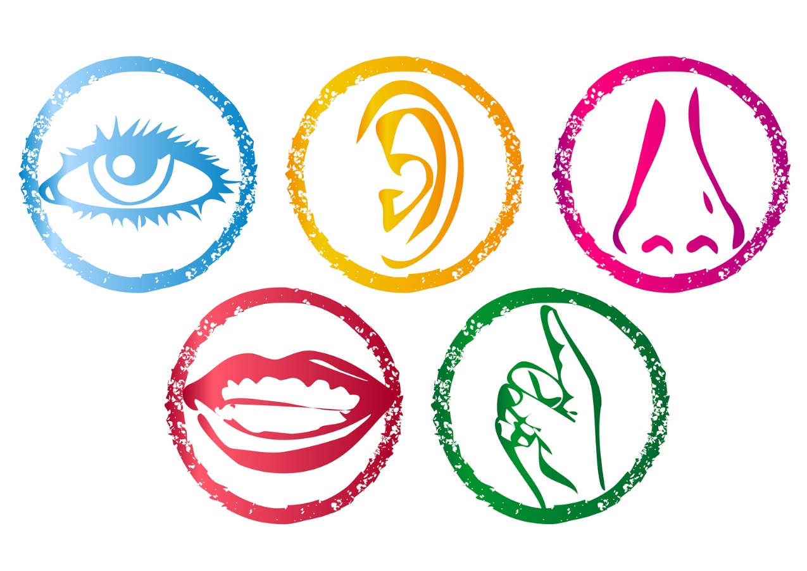
Senses
http://mariaalbatok.wordpress.com/category/tok/faith/
Notes:
Learning starts with our senses, so let’s review the five “classical senses.”
Sight, Hearing, Smelling, Taste, and Touch
“Over the course of our lives, sight, hearing, and touch contribute the most” (p. 45).
Sousa, D.A. (2011). How the brain learns. Thousand Oaks, CA: Corwin.

Slide 20
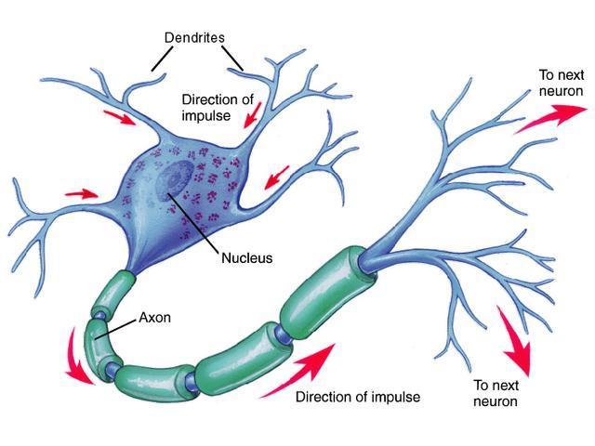
Neurons – Important Learning Messengers
Dendrites =
Receive messages
Axon =
Sends messages
Soma
http://www.akitarescueoftulsa.com/synapse-diagram-unlabeled/
Notes:
The dendrites receive messages from other neurons.
The messages travel through the soma (There’s so – mu(ch) to tell!)
The axon carries the message on to the next neuron. (p. 22)
Sousa, D.A. (2011). How the brain learns. Thousand Oaks, CA: Corwin.

Slide 21
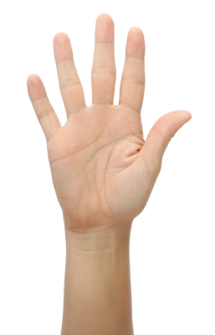
Neurons remind me of. . .
Dendrites
Soma
Axon
https://countryliving4beginners.wordpress.com/2013/01/23/raise-your-hand-if-it-hurts/
Notes:
Caviness, L. (2014). Lecture notes. Riverside, CA: La Sierra University.
Sousa, D.A. (2011). How the brain learns. Thousand Oaks, CA: Corwin.

Slide 22
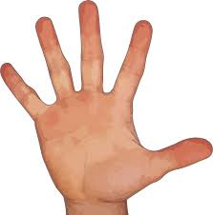
Message Route
Poked finger
To hand
Up arm
Over shoulder
To spinal cord
Up brain stem/Cerebellum
Into LIMBIC AREA
http://pixabay.com/en/photos/fingers/ and http://www.wpbeginner.com/plugins/pin-posts-with-post-admin-shortcuts-plugin/
Notes:
“Ouch! I poked my finger!” How does that message travel to the brain? How do I learn not to poke myself again?
Explain 1-7
Who send the message?
Let’s act it out (without poking ourselves)!
Sousa, D.A. (2011). How the brain learns. Thousand Oaks, CA: Corwin.

Slide 23
Gate
THALAMUS
http://glennstone.net/gate-system-fence-springfield-mo/
Notes:
Then the message arrives at the thalamus. Remember, the thalamus is the gate into the brain. It guards against all information coming in from the outside of the body. (p. 18)
The thalamus and the rest of the Limbic System will decide if this message is one the brain should pay attention too.
Do you think the brain will pay attention to the fact that your was poked? (Oh yes!)
Sousa, D.A. (2011). How the brain learns. Thousand Oaks, CA: Corwin.

Slide 24
Inside the brain > Immediate Memory
IMMEDIATE
MEMORY
30 seconds
http://www.clipartbest.com/clipboard-border
Notes:
After our senses tell us information, for example touch tells us that we were poked, the information goes to our “immediate memories.”
Immediate memory is “like a clipboard, a place where we put information briefly until we make a decision on how to dispose of it. . . about 30 seconds” (p. 46).
Sousa, D.A. (2011). How the brain learns. Thousand Oaks, CA: Corwin.

Slide 25
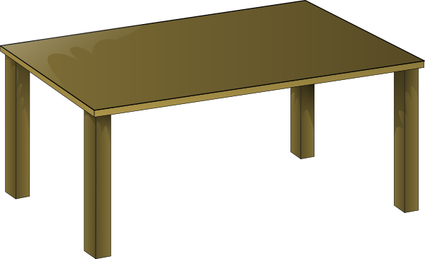
Working Memory
WORKING MEMORY 10 minutes
http://www.clipartpanda.com/categories/end-table-clipart
Notes:
If the brain think that immediate memory is important it moves to working memory.
Working memory is like a work table or desk. It is “a temporary memory and the place where conscious processing occurs” (p. 48).
“The working memory can handle only a few items at once” (p. 49).
Your working memory can handle about 4 items at once (p. 50).
Information stays in your working memory for about 10 minutes (p. 51).
Sousa, D.A. (2011). How the brain learns. Thousand Oaks, CA: Corwin.

Slide 26
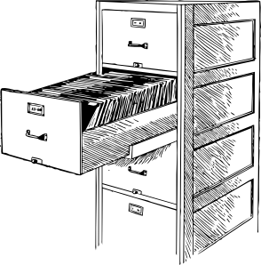
Long-Term Storage
LONG-TERM
STORAGE
http://www.clker.com/clipart-open-file-cabinet.html
Notes:
If your brain (hippocampus) decides the information may be needed in the future it moves the information to long-term storage if use later.
The Long-Term Storage is like a filing cabinet where you put important papers for later. (p. 55)
Sousa, D.A. (2011). How the brain learns. Thousand Oaks, CA: Corwin.

Slide 27
Let’s Review:
Prior Knowledge
Retrieving
Working Memory
Storing
Immediate Memory
Long-term Storage
Notes:
p. 43
Sousa, D.A. (2011). How the brain learns. Thousand Oaks, CA: Corwin.

Slide 28
Back to the pain message

Slide 29
Around the Brain ☺
Limbic System
Parietal Lobe (Somatosensory Cortex)
Occipital Lobe
Temporal Lobe
Frontal Lobe
Motor Cortex
Back through Limbic System
6. Brain Stem
Spinal Cord
Across shoulder
Down arm
To finger
http://pixabay.com/en/photos/fingers/ and http://www.wpbeginner.com/plugins/pin-posts-with-post-admin-shortcuts-plugin/
Notes:
The brain will use the info processing model we just discussed. The message will travel around the brain and back to the finger.
Trace the route with your finger.
Sousa, D.A. (2011). How the brain learns. Thousand Oaks, CA: Corwin.

Slide 30
Finally, a muscle response. . .
OUCH!
http://pixabay.com/en/photos/fingers/ and http://www.wpbeginner.com/plugins/pin-posts-with-post-admin-shortcuts-plugin/
Notes:
Finally, the muscle in your hand responds and you pull your hand away.
Next time the brain will remember the pain the pin caused and will remind you to be more careful because of your long-term memory. (p. 55)
Sousa, D.A. (2011). How the brain learns. Thousand Oaks, CA: Corwin.

Slide 31
That is how messages travel and how you learn.
Can you help your brain to learn?

Slide 32
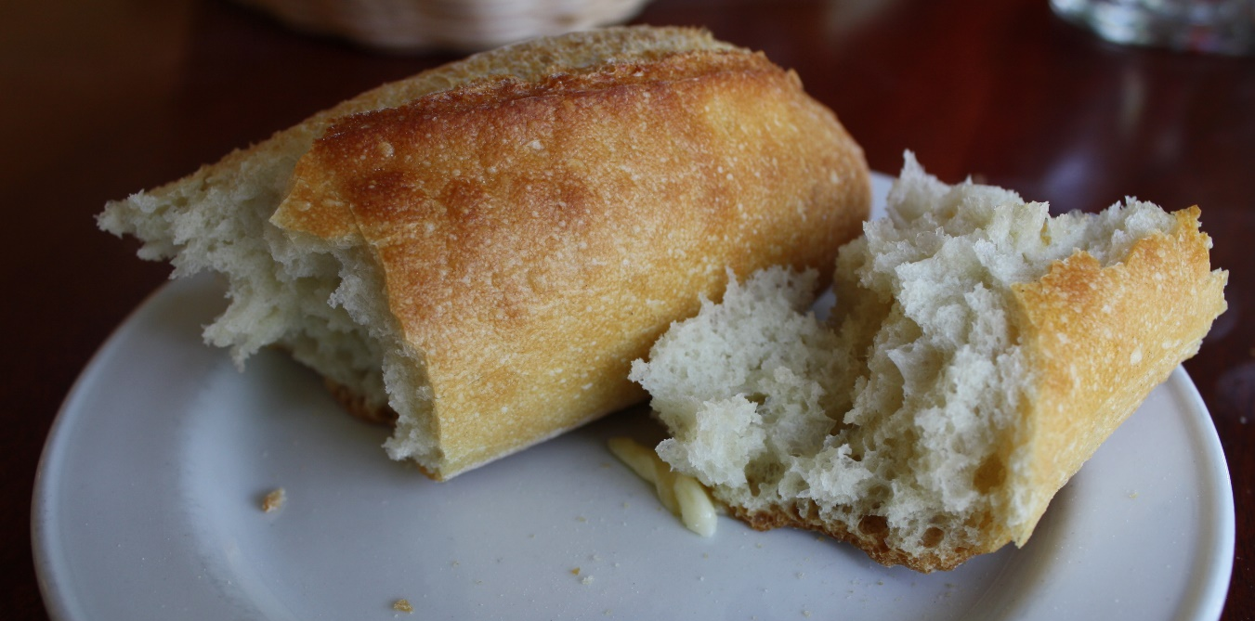
How to help your brain learn?
1. Chunking
DOGUSACA = DOG USA CA
http://www.blunderconstruction.com/2011/06/a-seat-at-jackys-table.html
Notes:
Chunking is “when working memory perceives a set of data as a single item [like one word – instead of each letter by itself]” Looking for patterns. (p. 117)
Think of eating a chunk of bread instead of one crumb or the whole loaf.
Sousa, D.A. (2011). How the brain learns. Thousand Oaks, CA: Corwin.

Slide 33
How to help your brain learn?
2. Mnemonics
Ukulele strings
G C E A
God created everyone awesome.
Notes:
A mnemonic is a “very useful device for remembering unrelated information, patterns, or rules” (p. 140).
Two types are rhyming and reduction (p. 140).
Sousa, D.A. (2011). How the brain learns. Thousand Oaks, CA: Corwin.

Slide 34
“More on Top” Mnemonic
More on top?
No need to stop.
More on the floor?
Go next door.
Numbers the same?
Zeroes the game.
http://it.pinellas.k12.fl.us/Teachers3/gurianb/files/E07E4B18CEC345F8B6913F2B9B28A0CC.pdf
http://www.eduplace.com/math/mw/background/2/06/te_2_06_subregroup_develop.html
Notes:
You already know this mnemonic!
Mnemonic: http://it.pinellas.k12.fl.us/Teachers3/gurianb/files/E07E4B18CEC345F8B6913F2B9B28A0CC.pdf

Slide 35
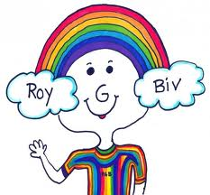
“Rainbow” Mnemonic = ROY G. BIV
https://sites.google.com/site/toolboxbellon2/home/strategy-9

Slide 36
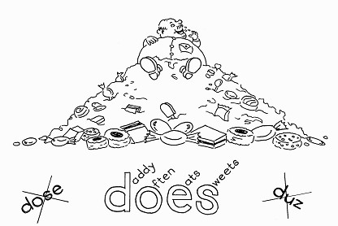
“Does” Mnemonic
http://www.dyslexiabooks.eu/#/shop/4558836030/mnemonics/669867

Slide 37
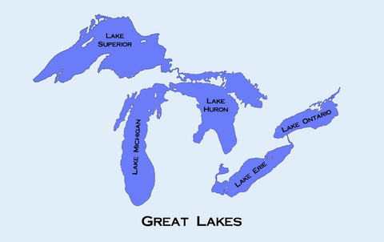
“HOMES” Mnemonic
H uron
O ntario
M ichigan
E rie
S uperior
http://archive.constantcontact.com/fs091/1101615682708/archive/1102471447062.html

Slide 38
Wow! Now you know a lot about your brain!
Good work 2nd Graders!

Slide 39
Reference:
Sousa, D.A. (2011). How the brain learns. Thousand Oaks, CA: Corwin.
* Picture references on each slide.

