Slide 1
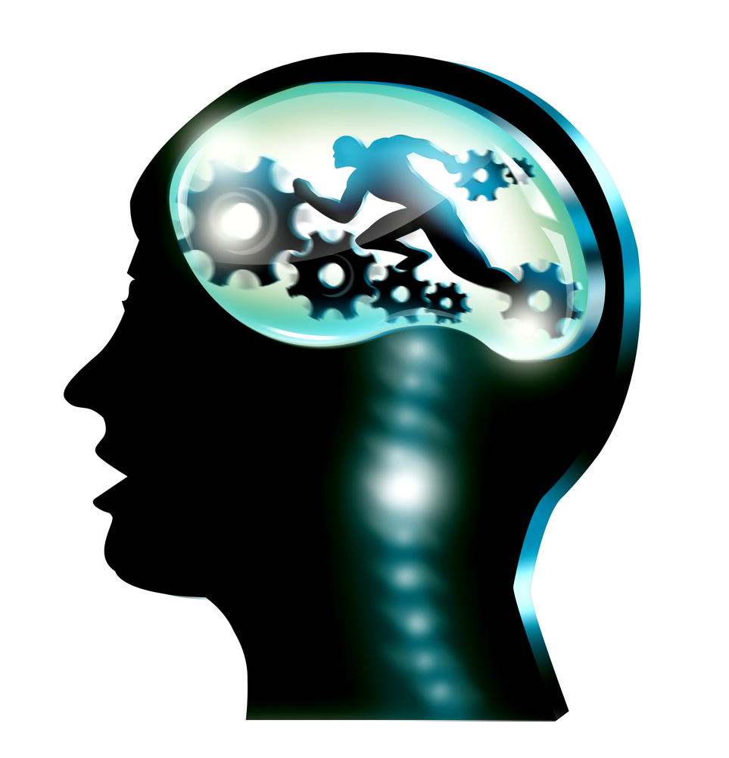
Exercise and the Mind
By Brandon Richards
Neuroscience

Slide 2
The Cerebellum
Coordinates movement.
In charge of Balance and muscle function.
Long-term memory
Spatial perception.

Slide 3
The Cerebellum
The Cerebellum is located in the back of the brain. (Wolfe, 26)
It is a two-lobed deeply folded structure which overlays the top of the brain stem. (Wolfe, 26)
The cerebellum is in charge of balance, maintenance of body posture, and coordination of muscle function. (Wolfe,26)
The cerebellum can store movement patterns in neural networks and then can call on them whenever they are needed. A great example of this is when you ride a bike, your muscle memory stores that information so the next time you get on the bike you don’t have to relearn anything or use training wheels.

Slide 4
The Cerebellum
The Cerebellum processes all of the information that is received in the movement like the muscular contractions in 1/50th of a second. The Cerebellum computes the contribution that various muscles will have to make to perform that movement and sends the correct messages to those muscles; which then make the necessary adjustments for completion of the action. (Wolfe, 26)
Information to the Cerebellum can also be received from the motor cortex, spinal cord, muscles and organs of balance in the vestibular area of the brain. (Wolfe, 27)
Having different receiving points allows the cerebellum to continually change the activity in the motor pathways that are required for keeping our bodies upright. (Wolfe, 27)

Slide 5
The Cerebellum
Coordinates the performance of learned motor skills like walking, driving a car, swinging a golf club, or tying a shoelace. (Sousa,237)
Newer scans have shown that the Cerebellum can do much more then what is mentioned above. The Cerebellums nerve fibers are able to communicate with other areas of the cerebrum. (Sousa, 237)
The Cerebellum plays a role in long-term memory, attention, spatial perception, impulse control and the cognitive functions of the frontal lobe. These are the same areas that are stimulated when learning. (Sousa,237)

Slide 6
Cerebellum
The Cerebellum is what allows us to move around without having to actually focus on moving, because of it’s ability to remember all different kinds of muscle memory. We are then able to focus on other things like a game plan in a basketball game or which road should I turn onto while riding a bike. Essentially the Cerebellum leaves the conscious mind free to do and think about other things.

Slide 7
The Cerebellum
There has also been a correlation with the Cerebellum and working memory, speech tasks and emotional processing. (Sousa, 237)
The more the Cerebellum is researched, the more of the realization that movement is linked to learning and memory. (Sousa, 237)

Slide 8
Thinking better on your feet
Studies show that physical activity increases the amount of oxygen in the blood, which the brain needs for fuel. (Sousa, 238)
Studies confirm that higher concentrations of oxygen in the blood significantly enhance cognitive performance in healthy young adults. (Sousa, 238)
Students are able to recall more words from a list and perform visual and spatial tasks faster. (Sousa, 238)
Creative solutions to complex problems can happen just by taking a walk. (Sousa, 238)

Slide 9
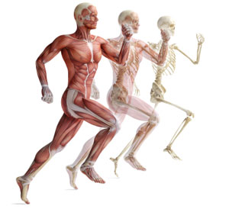
What Exercise can do for the body
Increased oxygen flow to the bloodstream (93).
The release of IGF-1, which triggers the release of brain-derived neurotrophic factor which stimulates neural growth and learning (94).
Exercise can induce neurogenesis (95).

Slide 10
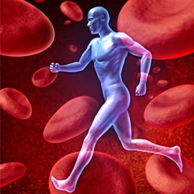
1. Increased Oxygen flow
Aerobic exercise has been shown to pump more blood throughout the body.
More blood means more oxygen.
Studies show that physical activity increases the amount of oxygen in the blood, which the brain needs for fuel. (Sousa, 238)
The concentration of oxygen affects the brain’s ability to carry out its tasks. (Sousa, 238)

Slide 11
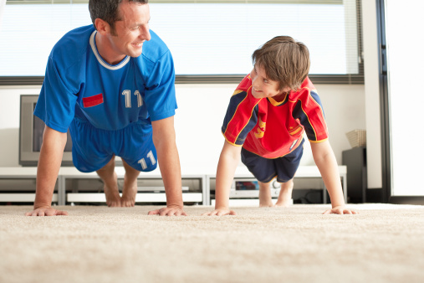
The Study
A study was done at University of Illinois, 259 3rd and 5th graders engaged in aerobic exercise routines like push-ups and timed running. After checking their physical results against their math and reading scores on a standards achievement test. The test showed that as the exercise increased the higher they scored on the achievement test.

Slide 12
2. Stimulation of neural growth and learning
Brain-Derived Neurotrophic Factor (BDNF) is like miracle grow on the brain.
We continue to grow new neurons throughout our lives.

Slide 13
Brain-Derived Neurotrophic Factor
When you exercise your blood pressure rises which then causes your brain to think you are in fight or flight mode. This will allow the brain to release BDNF proteins and endorphins. The effects deplete stress hormones and prevent the destruction of brain cells.
BDNF is part of a family of Nerotrophic factors that is part of neural transmission.
Studies have shown that BDNF levels increase when the subjects exercise.
BDNF

Slide 14
Hippocampus
Part of the temporal lobe.
Plays an important role in the bringing together of information from short term to long-term memory.
Physical exercise stimulates the birth of new neurons in the hippocampus that is critical for memory.

Slide 15
Neuron
Neurons are found primarily in the brain and spinal cord.
The brain has approximately 100 billion.
Neurons transmit information.

Slide 16
3. Exercise and neurogenesis

Slide 17
Dentate Gyrus and Olfactory bulb

Slide 18
Olfactory Bulb
Responsible for smell.
Receives information from the hippocampus.
Enhances sensitivity of odor detection.

Slide 19
Dentate Gyrus
Part of the Hippocampus.
The Dentate Gyrus has a functional role in depression and stress.
This is also one of the few places in the human brain where neurogenesis takes place.
The neurogenesis in the Dentate Gyrus also improves spatial memory.

Slide 20
Exercise on your psychosis part 1
Dopamine is released when there is physical activity. Dopamine is a neurotransmitter in the brain that is responsible for feeling happiness and pleasure.
Working out helps lower stress, because of the process of adding a lower level of stress on your body. The addition of stress can prepare your body to be able to handle a higher level of stress in the future.
Going on a walk or working out can give you more energy to do other things.

Slide 21
Exercise on your psychosis part 2
By exercising regularly it can boost your self esteem and overall self image you have of yourself.
The mood boost you receive from exercise can relieve your anxiety and make the relief last longer.
Regular exercise can improve your sleep and also make it easier to get out of your bed in the morning.

Slide 22
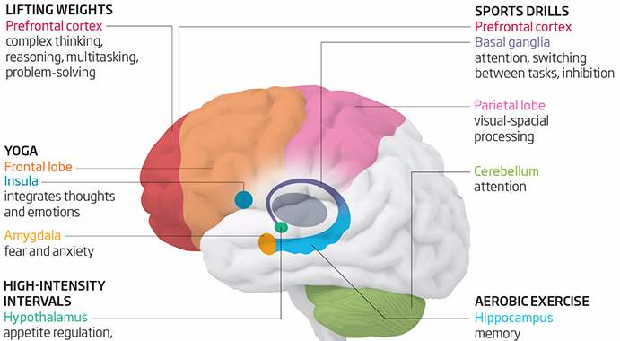
The way the brain learns with exercise

Slide 23
Schedule Homework breaks
It has been proven that taking breaks with students in your classroom can be very useful in helping your students to get out any extra energy as well as refocusing the students.

Slide 24
Ways to increase your students attention in the classroom
Often kids who struggle to maintain attention in class can benefit from a short 15 min. break.
Understand that younger kids attention spans last between 16-30 min.
Memory games can hone your students focus in a fun way and benefit from exercise as well.

Slide 25
Activities you can do in the classroom
Pushups
Walk around the classroom.
Stretches
Jumping jacks

Slide 26
Movement is connected to Cognitive learning
Teachers and Administrators are needed in encouraging more movement in all classrooms at all grade levels, not just elementary.
It would be good to include movement after each lesson to enhance the learning experience.
Encouraging kids to move around the classroom to discuss what they’ve just learned in class, is a good way to utilize classroom time.

Slide 27
What to do next?
I currently work for the South Umpqua School District in Oregon and the State of Oregon is requiring every school to have 30 min. of uninterrupted exercise every day.
Some of my co teachers use media platforms like go noodle in the classroom as a way of helping students use up kinesthetic energy. This will help your students to calm down and focus better.
I understand how it may seem difficult to plan for exercise in the classroom however there are many ways in which a teacher can implement it.

Slide 28
Ways to integrate exercise in the classroom
Give your students time to walk around and discuss what they have just learned with their classmates, proper supervision will be required.
Lead out in 5 min. stretches.
Play an exercise video from go noodle to get them moving.
Have them walk a few laps around in the classroom or encourage them to walk in place at their desks.

Slide 29
Conclusion
Unfortunately, there are still schools that are limiting their recess time and cutting out specials like Physical Education. In a time where we have more and more students who are hyperactive and distracted, we need more tools to help them learn. I know that exercise in the classroom is a free tool that can accomplish what is needed.
Exercise encourages more blood flow to the brain which is more oxygen, it then creates more neurons and helps the cerebellum in memorizing new muscle actions, not to mention the emotional stabilization that can occur.
In short, exercise is healthy for us emotionally, physically and academically. Exercise in the classroom is the future in improving learning in the classroom.

Slide 30
Work Cited
Fields, Dr. Douglas. (2011) Brain Health: How Exercise Can Stimulate the Birth of New Neurons. http://www.huffingtonpost.com/dr-douglas-fields/why-does-exercise-stimula_b_788581.html
Godman, Heidi. (2016) Regular exercise changes the brain to improve memory, thinking skills. http://www.health.harvard.edu/blog/regular-exercise-changes-brain-improve-memory-thinking-skills-201404097110
Sousa, David A. (2011) How the Brain Learns.
Willenborg, Kristie. (2016) Can Physical Exercise Make You Smarter. http://thevitalityinstitute.org/can-physical-exercise-make-smarter/
Wolfe, Patricia. (2010) Brain Matters: Translating Research into Classroom Practice.

