Slide 1
BRAIN AND LEARNING
By Jessica Chung

Slide 2
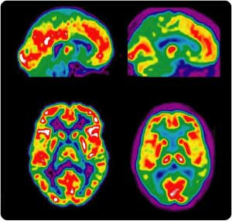
LOOKING INSIDE BRAIN
Different techniques:
X-Rays
CAT scans
EEG
PET
fMRI
Notes:
X-Rays: high-frequency electromagnetic waves; not very helpful
CAT scans: combines several 2-D images into 3D “slices” – not very helpful
EEG: measures electrical patterns based on neural activity; brain waves – 5 types
PET scans: uses radioactive tracer; can only do one scanning session (usually 12 scans) a year; does not show specific area; shows anatomical areas that are active while in process
fMRI: detailed; shows function of structures of brain & neural activity; can be repeated in seconds

Slide 3
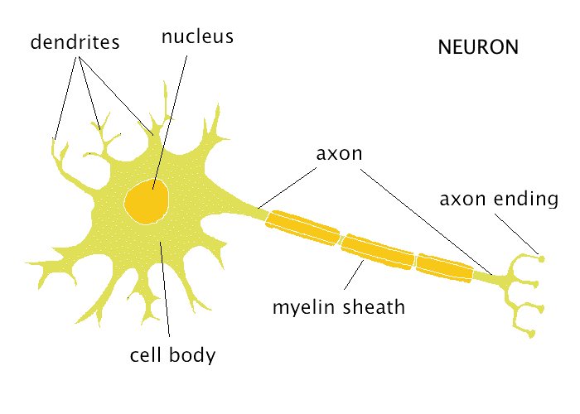
BRAIN ANATOMY
2 types of cells:
Neurons
Glial cells
Neurons transmit information
Glial cells = helper cells

Slide 4
NEURONS
3 Parts:
Dendrites
Soma
Axon

Slide 5
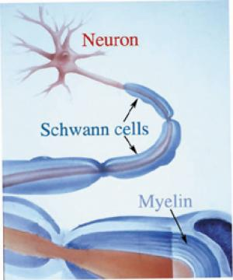
GLIAL CELLS
Types of glial cells:
Macrophage
Obligrodendrocytes
Astrocytes
Schwann cells
Notes:
Macrophage: clean up
Obligrodendrocytes: makes myelin
Astrocytes: blood brain barrier
Schwann cells: myelinates axons, especially in peripheral nervous system

Slide 6
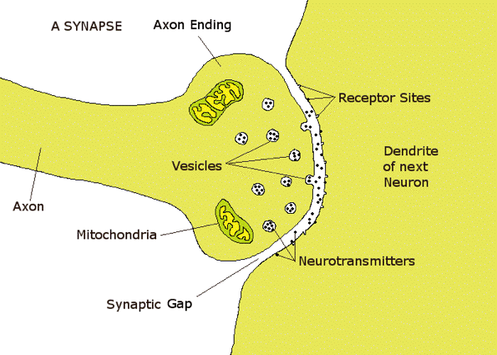
WHAT TAKES PLACE IN SYNAPSE?
→
Notes:
Chemical & electrical components come together
Action potential reaches terminal of axon which stimulates vesicles to open, and that triggers the release of neurotransmitters into synaptic cleft (gap separating axon terminal & dendrite)
Electrons of action potential = converted to chemical signal
Neurotransmitters reach other side of synapse which makes contact with target, postsynaptic or receiving neuron
As neuron adds up enough electrical signals from dendrites, neuron will fire
if task accomplished, clears synapse in 3 ways:
reuptake channels (axon terminals reabsorbs neurotransmitter molecules to “reuse” again
enzyme in synaptic cleft destroy some neurotransmitter molecules
other molecules diffused out and carried away as waste material by cerebrospinal fluid

Slide 7
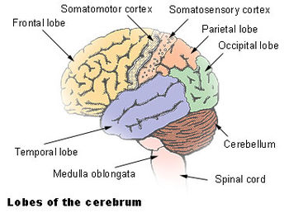
PARTS OF THE BRAIN
Cortical view:
Notes:
PONS located above medulla oblongata
Prefrontal cortex located towards the bottom part of frontal lobe
Brain stem: ensures body’s survival
Control of autonomic functions (especially medulla oblongata)

Slide 8
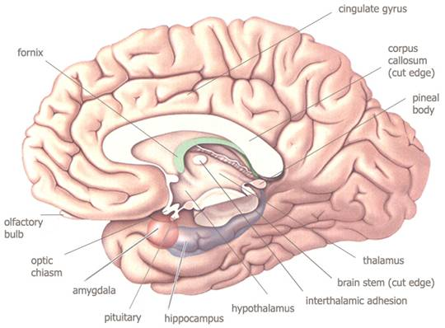
PARTS OF BRAIN (cont.)
Medial/sagittal view:

Slide 9
FRONTAL LOBE
Controls:
Planning
Voluntary movements
Verbalizing
Problem solving
Willpower
Higher-order thinking

Slide 10
PARIETAL LOBE
Processes:
Sensory information
Writing
Reading
Language
Calculations
“WHERE” is it?

Slide 11
OCCIPITAL LOBE
Processes vision
“WHAT” is it?

Slide 12
TEMPORAL LOBE
Processes:
Hearing
Language
Listening
Learning
Memory storage

Slide 13
LIMBIC SYSTEM
Contains:
Thalamus
Hypothalamus
Hippocampus
Amygdala
Notes:
Thalamus: relay station between sense organs and cortex (like “watchtower”)
Hypothalamus: maintains normal balance of body
Amygdala: fight-or-flight response; big part in control of emotions
Hippocampus: memories of immediate past (short-term memory); sends memory to cortex where it will become long-term memory

Slide 14
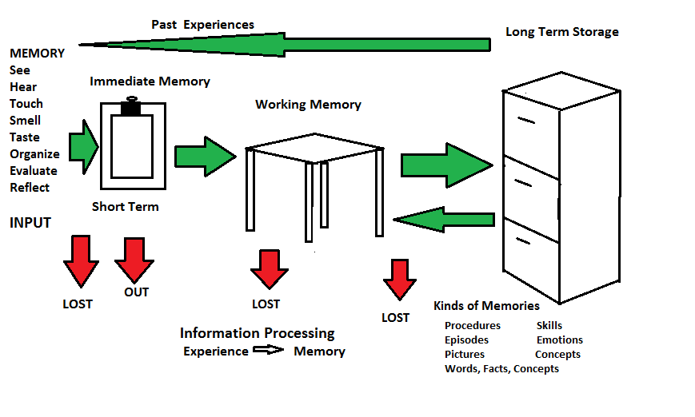
HOW BRAIN PROCESSES INFO.
Learning, storing, & remembering = dynamic & interactive process
Notes:
Begins with taking environmental input through senses
Next goes to immediate memory, one of two short-term memory places; operates subconsciously or consciously & holds data for up to 30 seconds
If not discarded, then goes to working memory; limited space where ideas are built upon, taken apart, or reworked for eventual storage elsewhere; most activity occurs in frontal lobe; although limited space, can increase # of items through “chunking” – grouping information into clusters; time limit = 15-20 minutes, in adults & adolescents
Long-term storage: information that is not lost throughout short-term memory process; takes time & occurs during deep sleep; dynamic and interactive system; can retrieve memories from long-term storage into working memory, but brain will remember newly created memory of it, not the prior memory

Slide 15
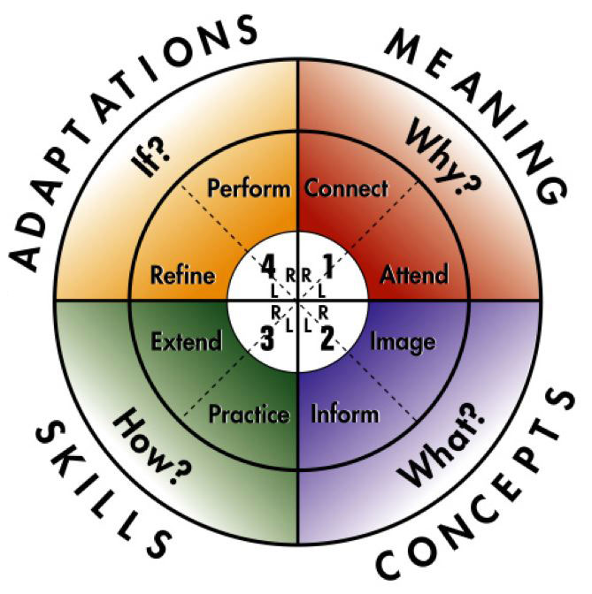
4MAT MODEL
McCarthy’s 4MAT model = model for teachers to follow in classrooms
People learn differently & model takes that into consideration
Notes:
4MAT: takes into consideration right brain & left brain learning
In classrooms, teachers typically teach in the 2-3 areas; children typically learn in the 1&4 areas
Important to touch upon every part of the model (if possible)
Horizontal axis = Active learning (left) and passive learning (right)
Vertical axis = concrete thinking (top), abstract thinking (bottom)
Areas 2&3 = extrinsic motivation; Areas 1&4 = intrinsic motivation
Quadrant 4 is where teachers can make authentic assessments

Slide 16
HOW TO ENHANCE LEARNING
Visual aids:
Graphs
Pictures
Can greatly increase students’ understanding & retention of information in curriculum
Notes:
While looking at pictures, able to transform thoughts into images and vice versa
Long-term memory capacity for pictures seems unlimited
Imagery is a process of mental visualization of objects, events, and arays related to the new learning – can help store information into brain

Slide 17
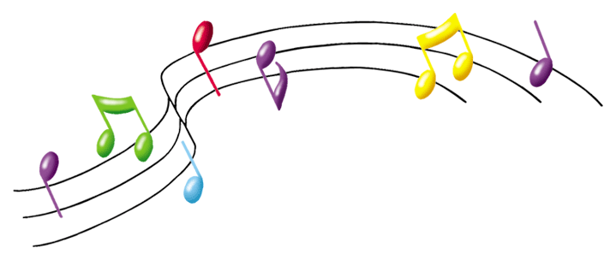
ENHANCE LEARNING (cont.)
Auditory aids/music:
Music can activate:
Cognitive
Visual
Auditory
Affective
Motor systems
Notes:
Relieves stress, diminishes pain, and treats other severe impairments
While listening to Mozart, it can increase spatial-termporal intelligence for short awhile “Mozart Effect”
Stimulates spatial thinking and neural networks can readily share cognitive abilities

Slide 18
ENHANCE LEARNING (cont.)
Movement
Physical exercise improves brain performance
Linked to learning and memory
Cerebellum plays important role
Recess gives children different opportunities
Notes:
Cerebellum plays important role in attention, long-term memory, spatial perception, impulse control, and frontal lobe’s cognitive functions
Recess gives students blood circulation (which is good for brain since brain needs oxygen), as well as opportunities for developing communication, social, & gross motor skills ~ students also learn how to listen, share, and cooperate

Slide 19
SOCIAL INFLUENCES – INTRO.
Social behavior essential for:
Reproduction
Survival
Social isolation & social separation = risk factors for medical disorders

Slide 20
MOTIVATED SOCIAL BEHAVIORS
Social attachment
Social affiliation
Sex behavior
Parental care

Slide 21
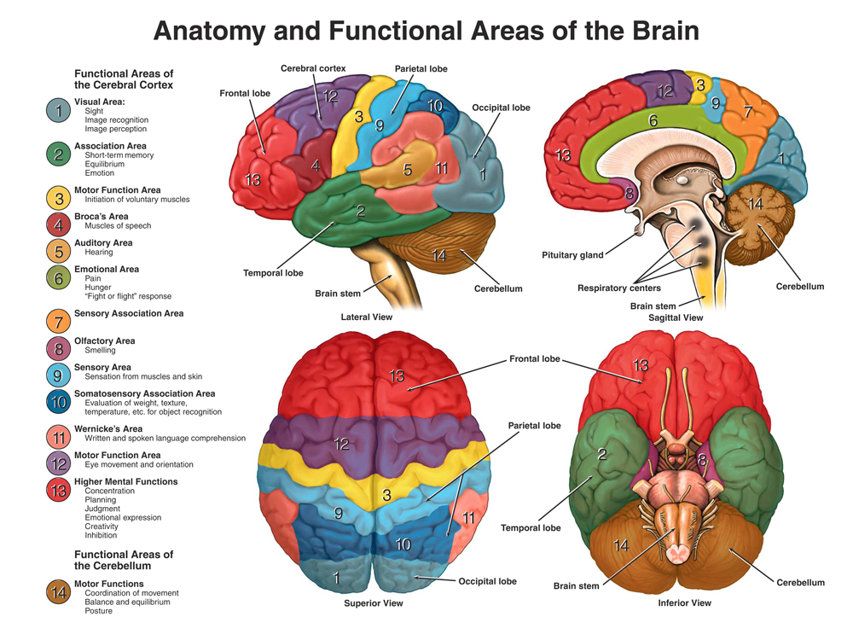
WHAT PARTS OF BRAIN?
Occipital temporal junction (especially for facial recognition)
Superior temporal sulcus, amygdala, ventromedial prefrontal cortex involved

Slide 22
WHAT PARTS OF BRAIN? (cont.)
Amygdala: recognition of social emotions & perception of fear
Ventromedial prefrontal cortex = pleasantness, social judgment, and processing of social vocalizations in nonhuman primates
Striatum, medial insula, anterior cingulate cortex in romantic attachment

Slide 23
HUMAN VS. MACHINE
Social interaction & social setting critical
Infants learn language better
DVDs & CDs not as effective
Social cues highlight what to learn & when
Students learn better face to face
Notes:
Infants learn language from native speaking person better than watching or listening to dvds (American toddlers learned to speak Mandarin Chinese by interacting with Mandarin speaking woman)

Slide 24
SOCIAL BEHAVIOR DEVELOPMENT
Infants can learn language
Learning trajectories influenced before going to school
Adolescents still developing in brain
Self-awareness
Social cognitive skills
Notes:
Family social interaction VERY important
Adolescents are still developing skills and social interactions are important in developing these skills; emotions are fully developed, but frontal lobe is not quite so much yet so by watching others and modeling others can learn socially appropriate behaviors

Slide 25
ENVIRONMENT STIMULI
Outdoor play important
Cognitive benefits: awareness, reasoning, observation skills, creativity, concentration, and imagination
Physical benefits: coordination, balance, & agility
Health benefits: reduced sickness & speedier recovery

Slide 26
ENVIRONMENTAL STIMULI (cont.)
No contact leads to:
Diminished senses
Attention difficulties
Disassociation from nature

Slide 27
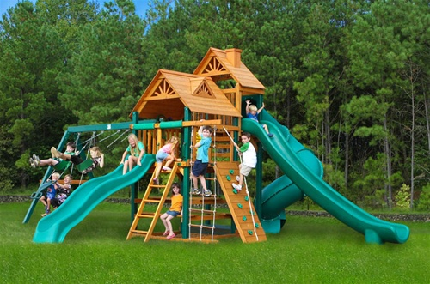
BENEFITS OF OUTDOOR PLAY
Diverse play behavior:
Learning
Problem solving
Developing social competence
Learning risk management
Rich setting for imagination & fantasy

Slide 28
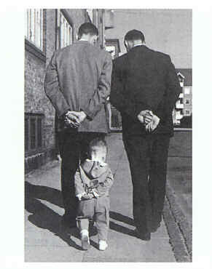
3 SOCIAL SKILLS
Imitation
Accelerates learning
Faster than individual discovery
Safer than trial-and-error learning
Choose whom, when, & what to imitate, mixed with self-discovery
Notes:
Toddlers saw adults struggling to open a bag; after several attempts, adults finally opens the bag; toddler will mimic the successful attempts and not the unsuccessful ones

Slide 29
3 SOCIAL SKILLS (cont.)
Shared Attention:
Same object/event = common ground for communication & teaching
Ex. Infant head turning
Interpret behavior & experience of others based on personal experience
Notes:
When robot turns head, babies less than 12 months follow the head motion; however, babies at age 1 years old will turn head only if robot’s eyes are open and head turns – however, if robot is blindfolded and turns head, babies will also turn head; not unless babies themselves are blindfolded will they understand that robots cannot see

Slide 30
3 SOCIAL SKILLS (cont.)
Empathy & Social Emotions:
Critical in understanding
Ex. Toddlers show empathy towards adults in pain
Overlap in neural systems (seeing painful stimulus vs. receiving painful stimulus)
Notes:
If adults “cut” themselves or show they have an “owwie,” toddlers will try to either kiss it or put a bandaid or show empathy

Slide 31
BENEFITS OF INTERACTION
Long-term improvements in:
Academic achievement
Social adjustment
Economic success

Slide 32
REFERENCES
Blakemore, S. J. (2010). The developing social brain: Implications for education.
Neuron, 65, 744–747.
Dowdell, K., Gray, T., & Malone, K. (2011). Nature and its influence on children's outdoor play. Australian Journal of Outdoor Education, 15(2), 24-35.
Insel, T. R., & Fernald, R. D. (2004). How the brain processes social information: Searching for the social brian. Annu. Rev. Neurosci., 27, 697-722.
Kuhl, Patricia. (2011). Early language learning and literacy: Neuroscience
implications for education. Mind Brain Educ. 5(3): 128–142.
doi:10.1111/j.1751-228X.2011.01121.x.
Meltzoff, A. N., Kuhl, P. K., Movellan, J., and Sejnowski, T. J. (2009). Foundations for
a new science of learning. Science. 325(5938): 284-288.
Nicoll-Senft, J. M., & Seider, S. N. (2010). Assessing the Impact of the 4MAT Teaching
Model Across Multiple Disciplines in Higher Education. College Teaching, 58(1), 19-27.
Sousa, D. A. (2011). How the brain learns. Corwin Press.
Tatar, E., & Dikici, R. (2009). The effect of the 4MAT method (learning styles and brain
hemispheres) of instruction on achievement in mathematics. International Journal
of Mathematical Education In Science And Technology, 40(8), 1027-1036.
Wolfe, P. (2010). Brain matters: Translating research into classroom practice. Association for Supervision & Curriculum Development.

